Slide 1
Welcome to . . . .
St Mary’s,
Holiday Bible Club 2013

Slide 2
Allelu, Allelu, Allelu, Allelujah
Praise you the Lord, X 2
Praise you the Lord,
Allelujah,
X 3
Praise you the Lord.

Slide 3
Workers
Briefing

Slide 4
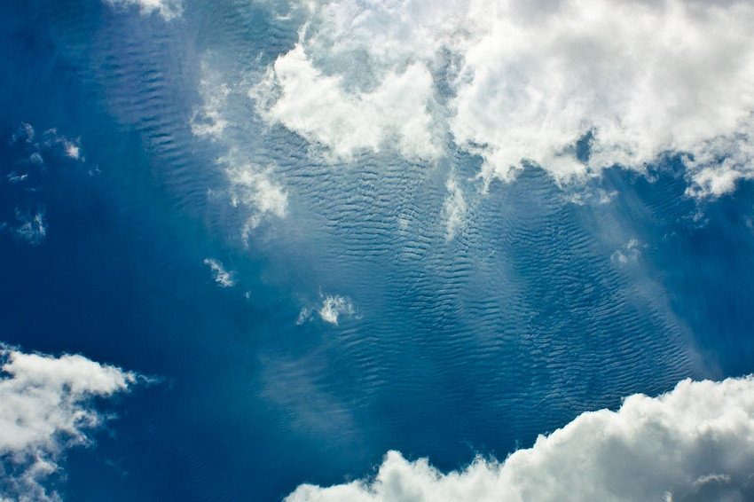
The Beginning of the World
¹ In the beginning God created the sky and the earth.

Slide 5
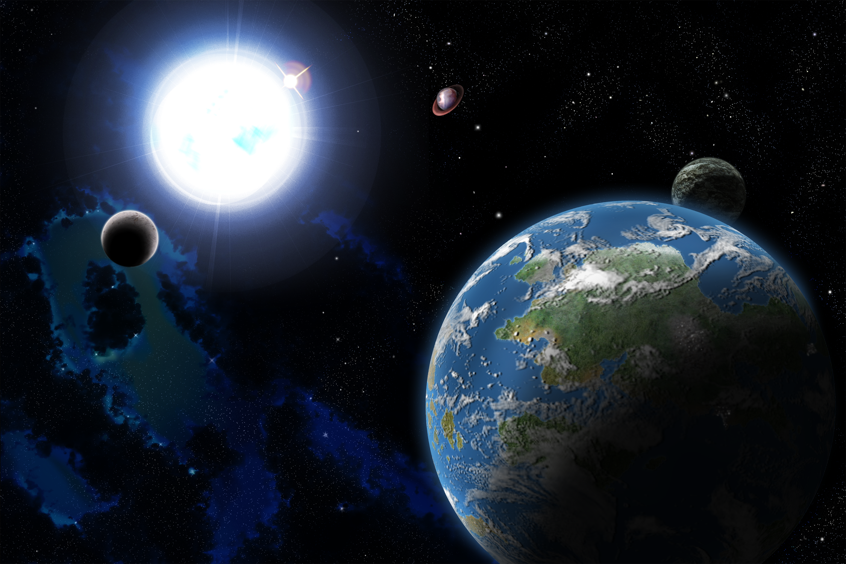
³¹ God looked at everything he had made, and it was very good.

Slide 6
Our God is a Great BIG God,
Our God is a Great BIG God,
Our God is a Great BIG God,
And He holds us in His hands.
X 2

Slide 7
He’s higher than a skyscraper,
And He’s deeper than a submarine, He’s wider than the universe,
And beyond my wildest dreams,

Slide 8
And He’s known me and He’s loved me,
Since before the world began,
How wonderful to be a part
Of God’s amazing plan.

Slide 9
Our God is a Great BIG God,
Our God is a Great BIG God,
Our God is a Great BIG God,
And He holds us in His hands.

Slide 10
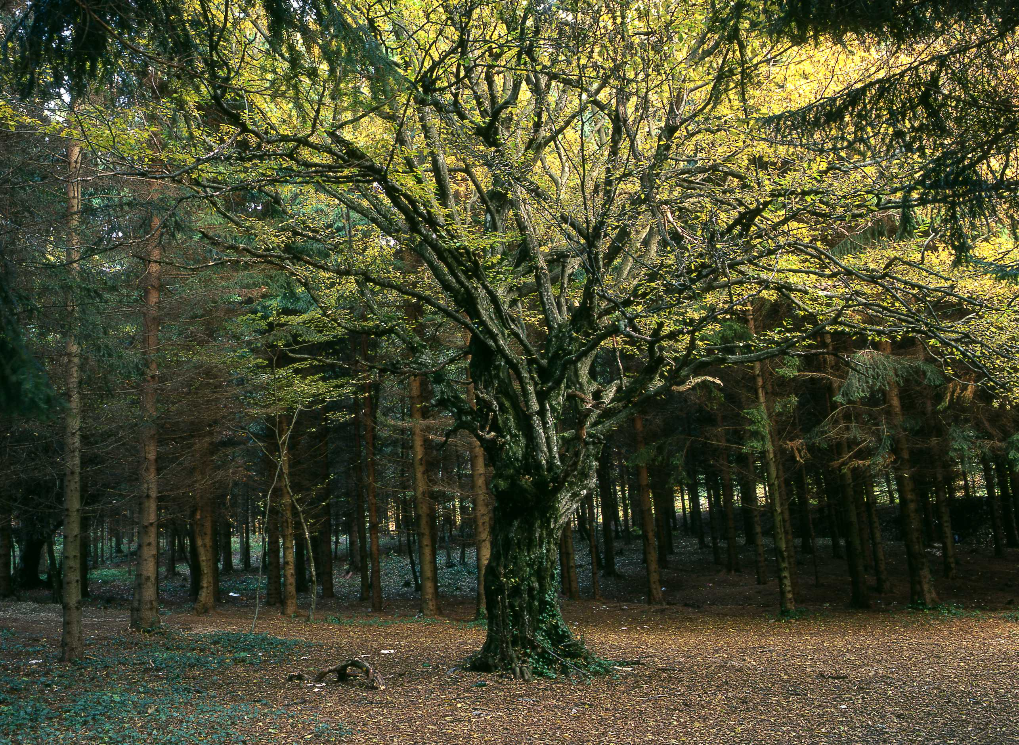
¹⁶ The Lord God commanded him, "You may eat the fruit from any tree in the garden,¹⁷ but you must not eat the fruit from the tree which gives the knowledge of good and evil. If you ever eat fruit from that tree, you will die!"

Slide 11
SIN
Shove off God!
I’m in charge!
No to your rules!

Slide 12
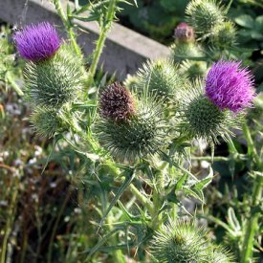
¹⁷ Then God said to the man, "I will put a curse on the ground, and you will have to work very hard for your food. In pain you will eat its food all the days of your life.

Slide 13
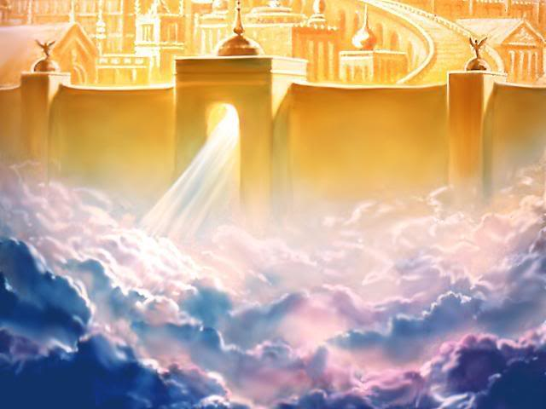
The New Jerusalem
¹ Then I saw a new heaven and a new earth. The first heaven and the first earth had disappeared.

Slide 14
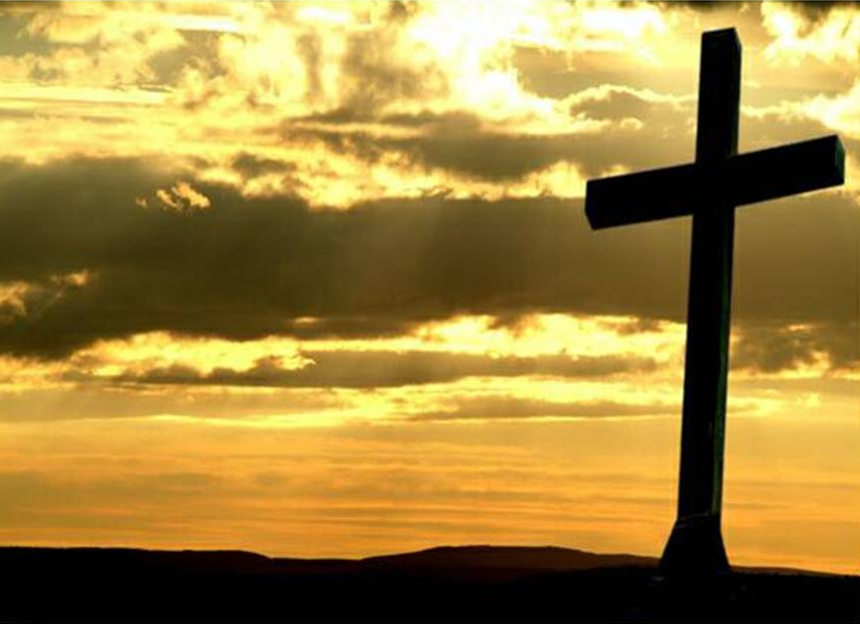
¹⁸ Christ himself suffered for sins once. He was not guilty, but he suffered for those who are guilty to bring you to God.

Slide 15
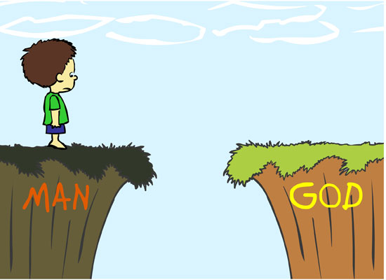
Jesus

Slide 16
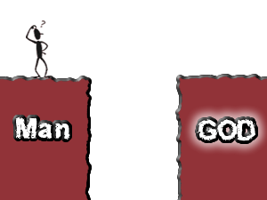

Slide 17
There will come a day, The Lord did say, When my people will be made new. I will lead them back to me And they will be made new, And they will be made new.

Slide 18
There will come a day, The Lord did say, When my people will be made new. I’ll forgive their sinfulness And they will be made new, And they will be made new.

Slide 19
There will come a day, The Lord did say, When my people will be made new. I will make them clean and pure And they will be made new, And they will be made new.

Slide 20
There will come a day, The Lord did say, When my people will be made new. Jesus came to seek and save And we have been made new, And we have been made new.

Slide 21
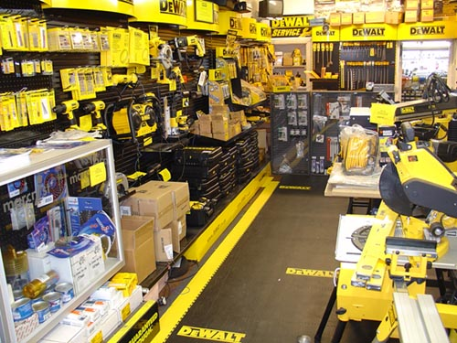
Fixit Factory QUIZ

Slide 22
Workers
Workshops

Slide 23
Workers
DeBrief

Slide 24
“The One who was sitting on the throne said, "Look! I am making everything new!".”
Rev 21v5

Slide 25
“The _ _ _ who was sitting on the _ _ _ _ _ _ said, “_ _ _ _ ! I am making _ _ _ _ _ _ _ _ _ _ new!".”
_ _ _ 21v5

Slide 26
“The _ _ _ _ _ _ was _ _ _ _ _ _ _ on the _ _ _ _ _ _ _ _ _ _ , “_ _ _ _ ! I am _ _ _ _ _ _ _ _ _ _ _ _ _ _ _ _ new!".”
_ _ _ _ _ v _

Slide 27
“_ _ _ _ _ _ _ _ _ _ _ _ _ _ _ _ _ _ _ _ _ _ _ _ _ _ _ _ _ _ _ _ _ _ , “_ _ _ _ ! _ _ _ _ _ _ _ _ _ _ _ _ _ _ _ _ _ _ _ _ _ _ !".”
_ _ _ _ _ v _

Slide 28
“The One who was sitting on the throne said, "Look! I am making everything new!".”
Rev 21v5

Slide 29
Who’s the King of the jungle? “OOO OOO” Who’s the King of the sea? “Bubble, bubble, bubble” Who’s the King of the universe? And who’s the King of me?

Slide 30
I’ll tell you . . . . . J – E – S – U – S Yes! He’s the King of me! He’s the King of the universe, the jungle and the sea! “Bubble, bubble, bubble . . . . OOO OOO!”

Slide 31
Clocking out!

Slide 33
Workers
Lunch

Slide 34
Daily Summary

Slide 35
You might have seen bad things happening
On the TV news
You might be worryin' 'bout the world
And wonder what will happen to you
Well put your trust in God alone
'Cos He's still sittin' on His mighty throne

Slide 36
The Lord is King
He's gonna look after everything
Everything
The Lord is King
He's gonna look after everything
Every single thing in this world
'Cos this is His world

Slide 37
You might get sad and wonder
Why there's so much pain
Why we let the same mistakes
Happen over and over again
Our sinful ways will always fail
But God and His ways will prevail because . . . .

Slide 38
The Lord is King
He's gonna look after everything
Everything
The Lord is King
He's gonna look after everything
Every single thing in this world
'Cos this is His world

Slide 39
You kings be wise you rulers
Hear the Lord's decree
He sees He knows He'll judge
In fearsome majesty
But blessed are all who find their place
In the shelter of His grace because

Slide 40
The Lord is King
He's gonna look after everything
Everything
The Lord is King
He's gonna look after everything
Every single thing in this world
'Cos this is His world

Slide 42
Almighty Creator
You spoke and there was light
There was light
And by Your great power
You spoke and there was day
And there was night
And you made all things to show Your glory
Formed all things to bring You praise

Slide 43
And You’ve created me to worship You
And You’ve created me to love You
And You’ve made me to delight in You
All glory to Your name

Slide 44
The mountains, the oceans
All creatures great and small
In the earth
All nations, all peoples
Of all colours came to be
By Your word
And You shed your blood for our salvation
So You could make us anew

Slide 45
And You’ve created me to worship You
And You’ve created me to love You
And You’ve made me to delight in You
All glory to Your name

Slide 47
Day one God’s work begun: The light and dark He made apart. Day two Still more to do. The sky and sea Were made to be.

Slide 48
And it was good, Just as it should. As all creation God did form By the power of His word, The power of His word.

Slide 49
Day three Came plants and trees, As by His hand God made the land. Day four God still made more: The moon for night And sun for light.

Slide 50
And it was good, Just as it should. As all creation God did form By the power of His word, The power of His word.

