Slide 1
Welcome to . . . .
St Mary’s,
Holiday Bible Club 2013

Slide 2
Allelu, Allelu, Allelu, Allelujah
Praise you the Lord, X 2
Praise you the Lord,
Allelujah,
X 3
Praise you the Lord.

Slide 3
Workers
Briefing

Slide 4
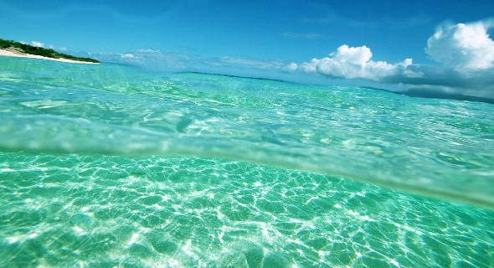
9 Then God said, "Let the water under the sky be gathered together so the dry land will appear." And it happened.10 God named the dry land "earth" and the water that was gathered together "seas."

Slide 5
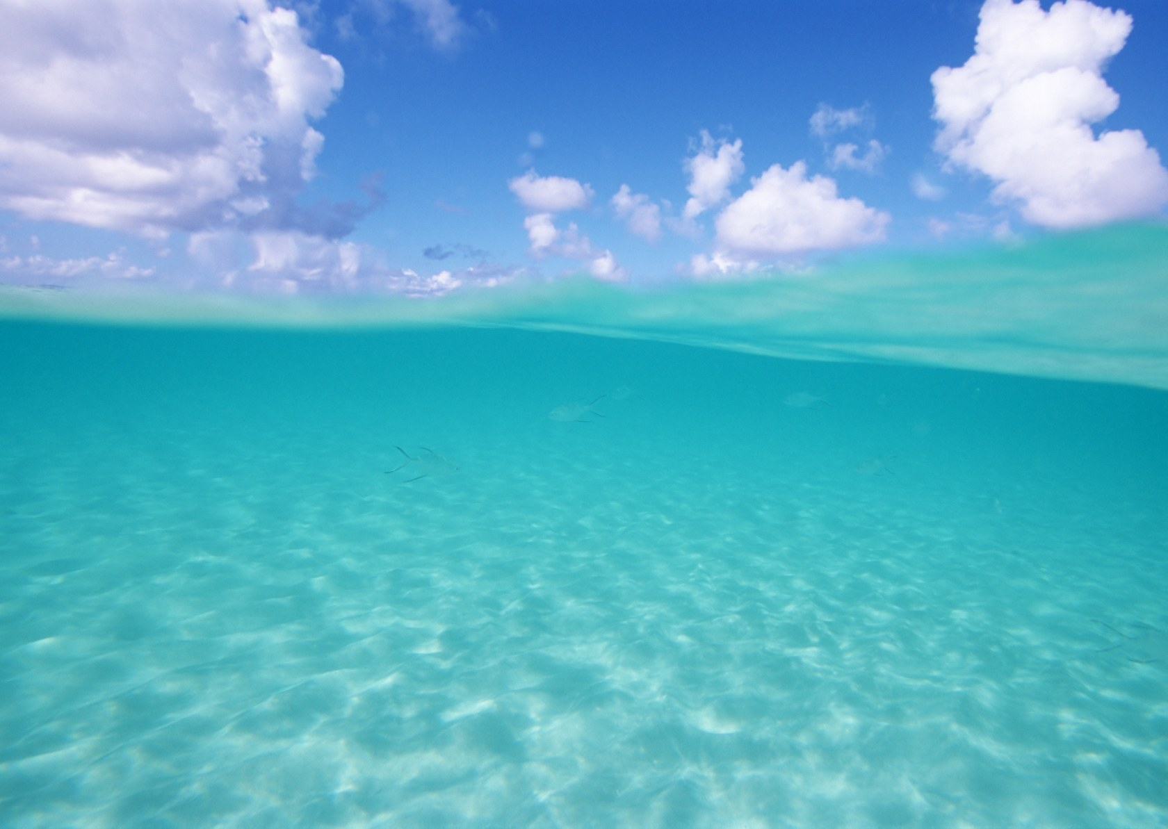
³¹ God looked at everything he had made, and it was very good.

Slide 6
Our God is a Great BIG God,
Our God is a Great BIG God,
Our God is a Great BIG God,
And He holds us in His hands.
X 2

Slide 7
He’s higher than a skyscraper,
And He’s deeper than a submarine, He’s wider than the universe,
And beyond my wildest dreams,

Slide 8
And He’s known me and He’s loved me,
Since before the world began,
How wonderful to be a part
Of God’s amazing plan.

Slide 9
Our God is a Great BIG God,
Our God is a Great BIG God,
Our God is a Great BIG God,
And He holds us in His hands.

Slide 10
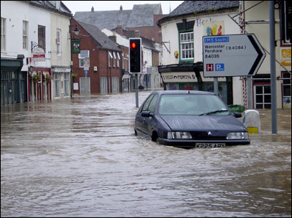
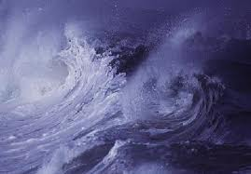
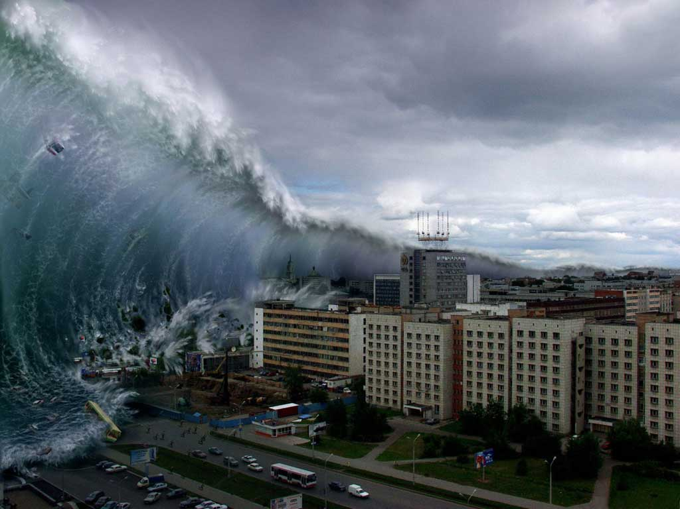
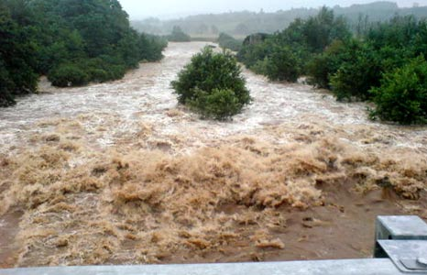

Slide 11
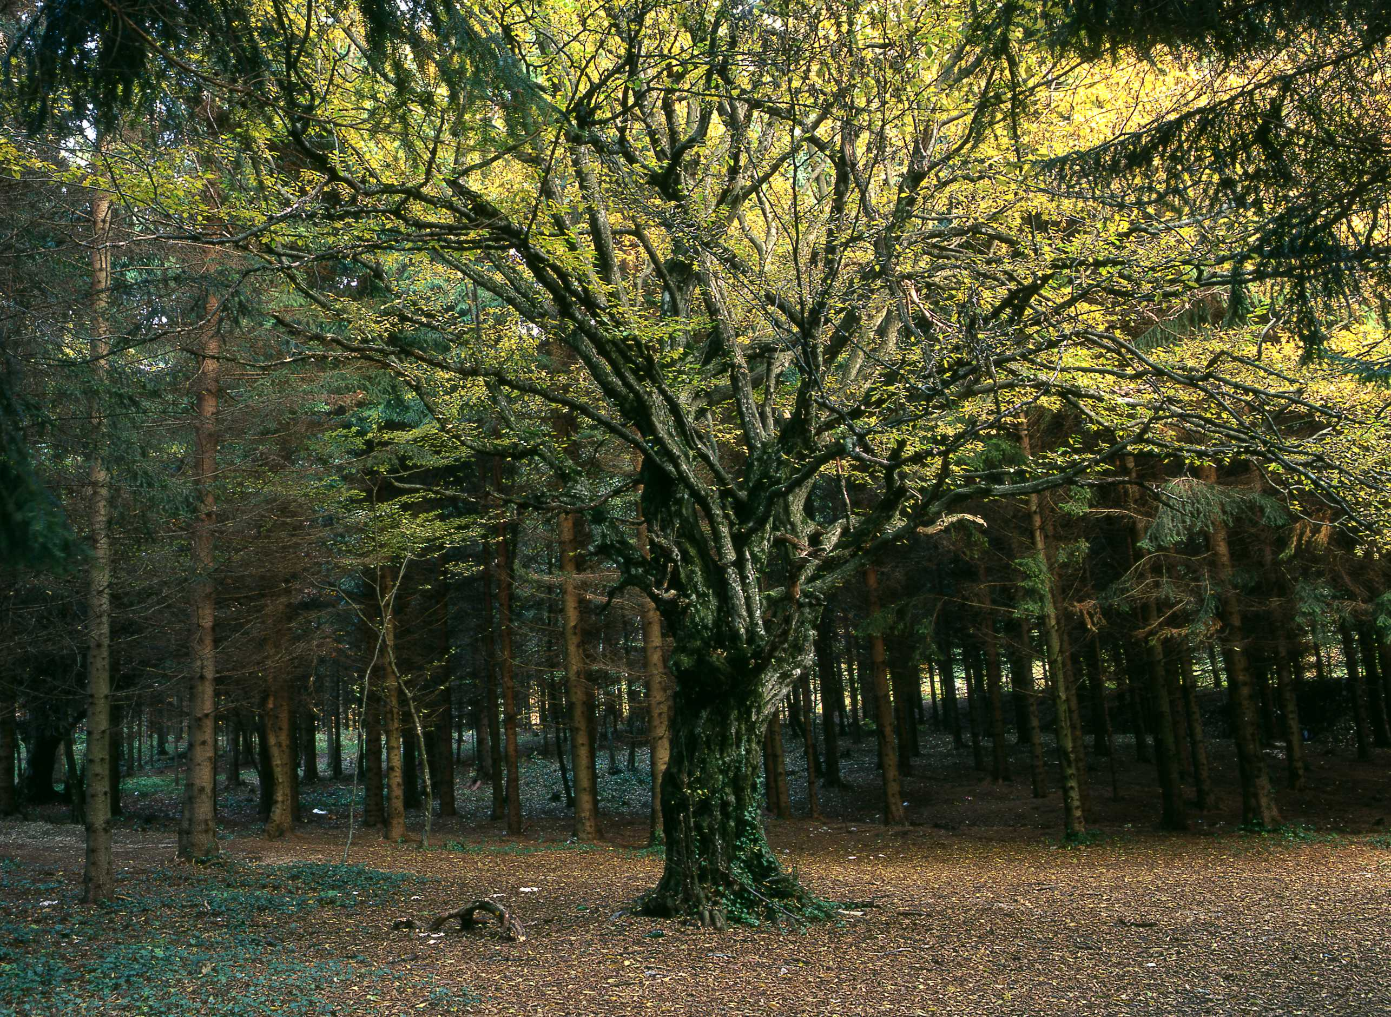
¹⁶ The Lord God commanded him, "You may eat the fruit from any tree in the garden,¹⁷ but you must not eat the fruit from the tree which gives the knowledge of good and evil. If you ever eat fruit from that tree, you will die!"

Slide 12
SIN
Shove off God!
I’m in charge!
No to your rules!

Slide 13
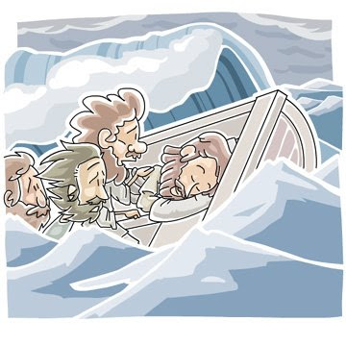

Slide 14
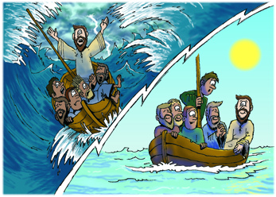

Slide 15
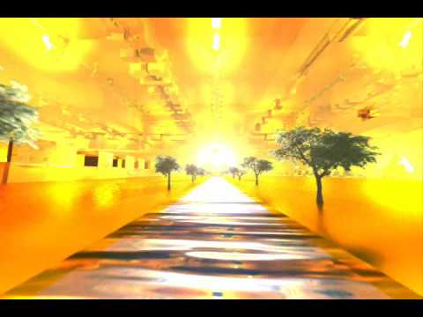
¹ Then the angel showed me the river of the water of life. It was shining like crystal and was flowing from the throne of God and of the Lamb² down the middle of the street of the city.

Slide 16
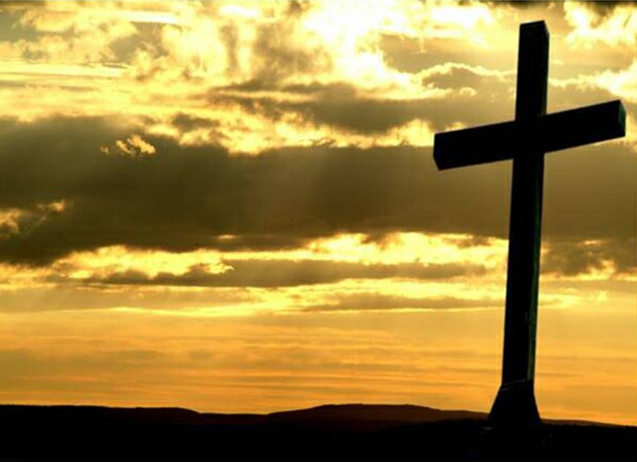
¹⁸ Christ himself suffered for sins once. He was not guilty, but he suffered for those who are guilty to bring you to God.

Slide 17
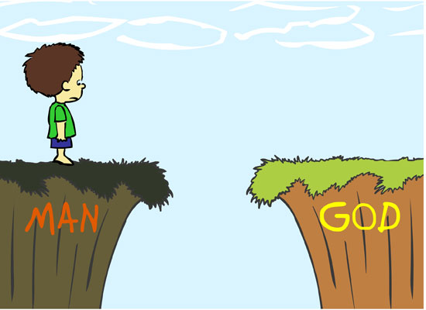
Jesus

Slide 18
There will come a day, The Lord did say, When my people will be made new. I will lead them back to me And they will be made new, And they will be made new.

Slide 19
There will come a day, The Lord did say, When my people will be made new. I’ll forgive their sinfulness And they will be made new, And they will be made new.

Slide 20
There will come a day, The Lord did say, When my people will be made new. I will make them clean and pure And they will be made new, And they will be made new.

Slide 21
There will come a day, The Lord did say, When my people will be made new. Jesus came to seek and save And we have been made new, And we have been made new.

Slide 22
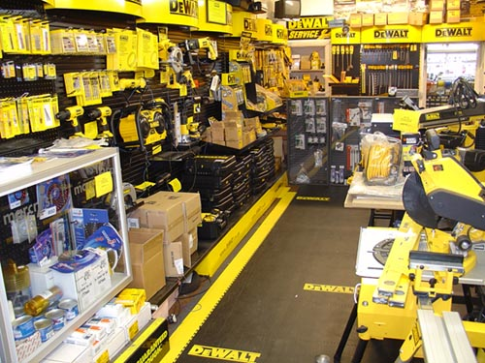
Fixit Factory QUIZ

Slide 23
Workers
Workshops

Slide 24
Workers
DeBrief

Slide 25
“_ _ _ _ _ _ _ _ _ _ _ _ _ _ _ _ _ _ _ _ _ _ _ _ _ _ _ _ _ _ _ _ _ _ , “_ _ _ _ ! _ _ _ _ _ _ _ _ _ _ _ _ _ _ _ _ _ _ _ _ _ _ !".”
_ _ _ _ _ v _

Slide 26
“The One who was sitting on the throne said, "Look! I am making everything new!".”
Rev 21v5

Slide 27
“What kind of man is this! Even the wind and waves obey Him".”
Mark 4v41

Slide 28
“What _ _ _ _ of man is this! _ _ _ _ the wind and _ _ _ _ _ obey _ _ _ ".”
Mark _ v41

Slide 29
“What _ _ _ _ of _ _ _ is _ _ _ _ ! _ _ _ _ the _ _ _ _ _ _ _ _ _ _ _ _ obey _ _ _ ".”
_ _ _ _ _ v41

Slide 30
“ _ _ _ _ _ _ _ _ _ _ _ _ _ _ _ _ _ _ _ ! _ _ _ _ _ _ _ _ _ _ _ _ _ _ _ _ _ _ _ _ _ _ _ _ _ _ ".”
_ _ _ _ _ v _ _

Slide 31
“What kind of man is this! Even the wind and waves obey Him".”
Mark 4v41

Slide 32
Who’s the King of the jungle? “OOO OOO” Who’s the King of the sea? “Bubble, bubble, bubble” Who’s the King of the universe? And who’s the King of me?

Slide 33
I’ll tell you . . . . . J – E – S – U – S Yes! He’s the King of me! He’s the King of the universe, the jungle and the sea! “Bubble, bubble, bubble . . . . OOO OOO!”

Slide 34
Clocking out!

Slide 36
Workers
Lunch

Slide 37
Daily Summary

Slide 38
“ _ _ _ _ _ _ _ _ _ _ _ _ _ _ _ _ _ _ _ ! _ _ _ _ _ _ _ _ _ _ _ _ _ _ _ _ _ _ _ _ _ _ _ _ _ _ ".”
_ _ _ _ _ v _ _

Slide 39
“What kind of man is this! Even the wind and waves obey Him".”
Mark 4v41

Slide 40
“ _ _ _ _ _ _ _ _ _ _ _ _ _ _ _ _ _ _ _ _ _ _ _ _ _ _ _ _ _ _ _ _ _ _ , “_ _ _ _ ! _ _ _ _ _ _ _ _ _ _ _ _ _ _ _ _ _ _ _ _ _ _ !".”
_ _ _ _ _ v _

Slide 41
He is the world creating, always speaking, Sin forgiving, people freeing Strong and Mighty so amazing God Repeat

Slide 42
He rescues us from sin He calls and lead us on To show how much He loves us He sent His precious son

Slide 43
He is the world creating, always speaking, Sin forgiving, people freeing Strong and Mighty so amazing God Repeat

Slide 44
So Jesus came to earth to live and then to die Though people crucified Him He rose to life on high

Slide 45
He is the world creating, always speaking, Sin forgiving, people freeing Strong and Mighty so amazing God Repeat

Slide 46
God sends his Holy Spirit to be with us each day To help us live like Jesus and follow in His way

Slide 47
He is the world creating, always speaking, Sin forgiving, people freeing Strong and Mighty so amazing God Repeat

Slide 48
Almighty Creator
You spoke and there was light
There was light
And by Your great power
You spoke and there was day
And there was night
And you made all things to show Your glory
Formed all things to bring You praise

Slide 49
And You’ve created me to worship You
And You’ve created me to love You
And You’ve made me to delight in You
All glory to Your name

Slide 50
The mountains, the oceans
All creatures great and small
In the earth
All nations, all peoples
Of all colours came to be
By Your word
And You shed your blood for our salvation
So You could make us anew

Slide 51
And You’ve created me to worship You
And You’ve created me to love You
And You’ve made me to delight in You
All glory to Your name

