Slide 1
Welcome to . . . .
St Mary’s,
Holiday Bible Club 2013

Slide 2
Allelu, Allelu, Allelu, Allelujah
Praise you the Lord, X 2
Praise you the Lord,
Allelujah,
X 3
Praise you the Lord.

Slide 3
Workers
Briefing

Slide 4
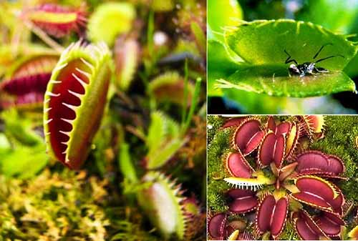
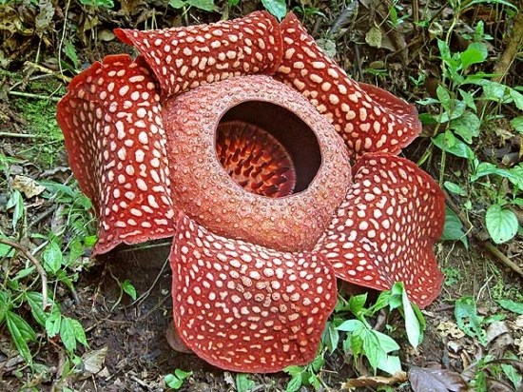
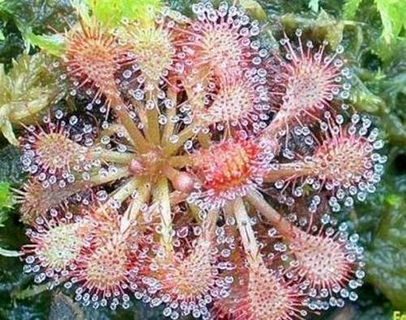
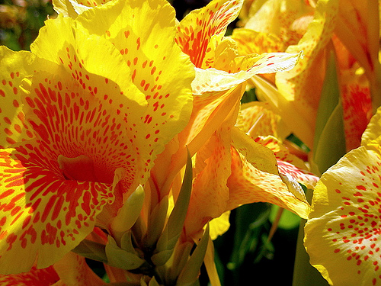

Slide 5
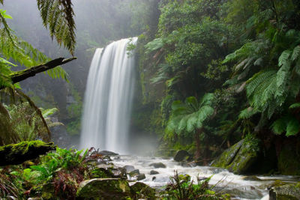
¹¹ Then God said, "Let the earth produce plants - some to make grain for seeds and others to make fruits with seeds in them. Every seed will produce more of its own kind of plant." And it happened.

Slide 6
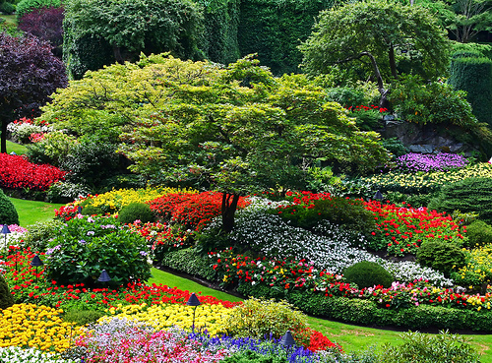
³¹ God looked at everything He had made, and it was very good.

Slide 7
Our God is a Great BIG God,
Our God is a Great BIG God,
Our God is a Great BIG God,
And He holds us in His hands.
X 2

Slide 8
He’s higher than a skyscraper,
And He’s deeper than a submarine, He’s wider than the universe,
And beyond my wildest dreams,

Slide 9
And He’s known me and He’s loved me,
Since before the world began,
How wonderful to be a part
Of God’s amazing plan.

Slide 10
Our God is a Great BIG God,
Our God is a Great BIG God,
Our God is a Great BIG God,
And He holds us in His hands.

Slide 11
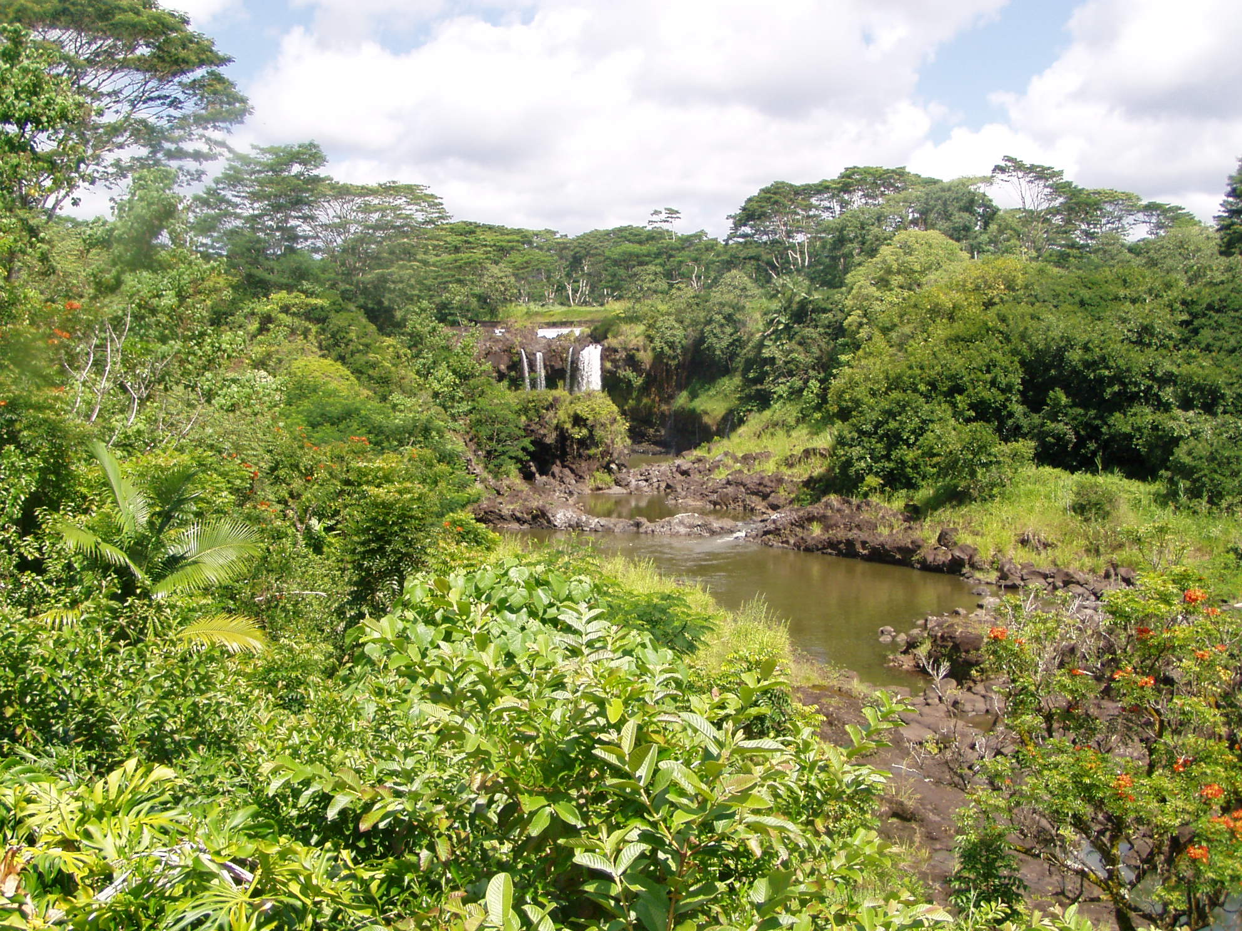

Slide 12
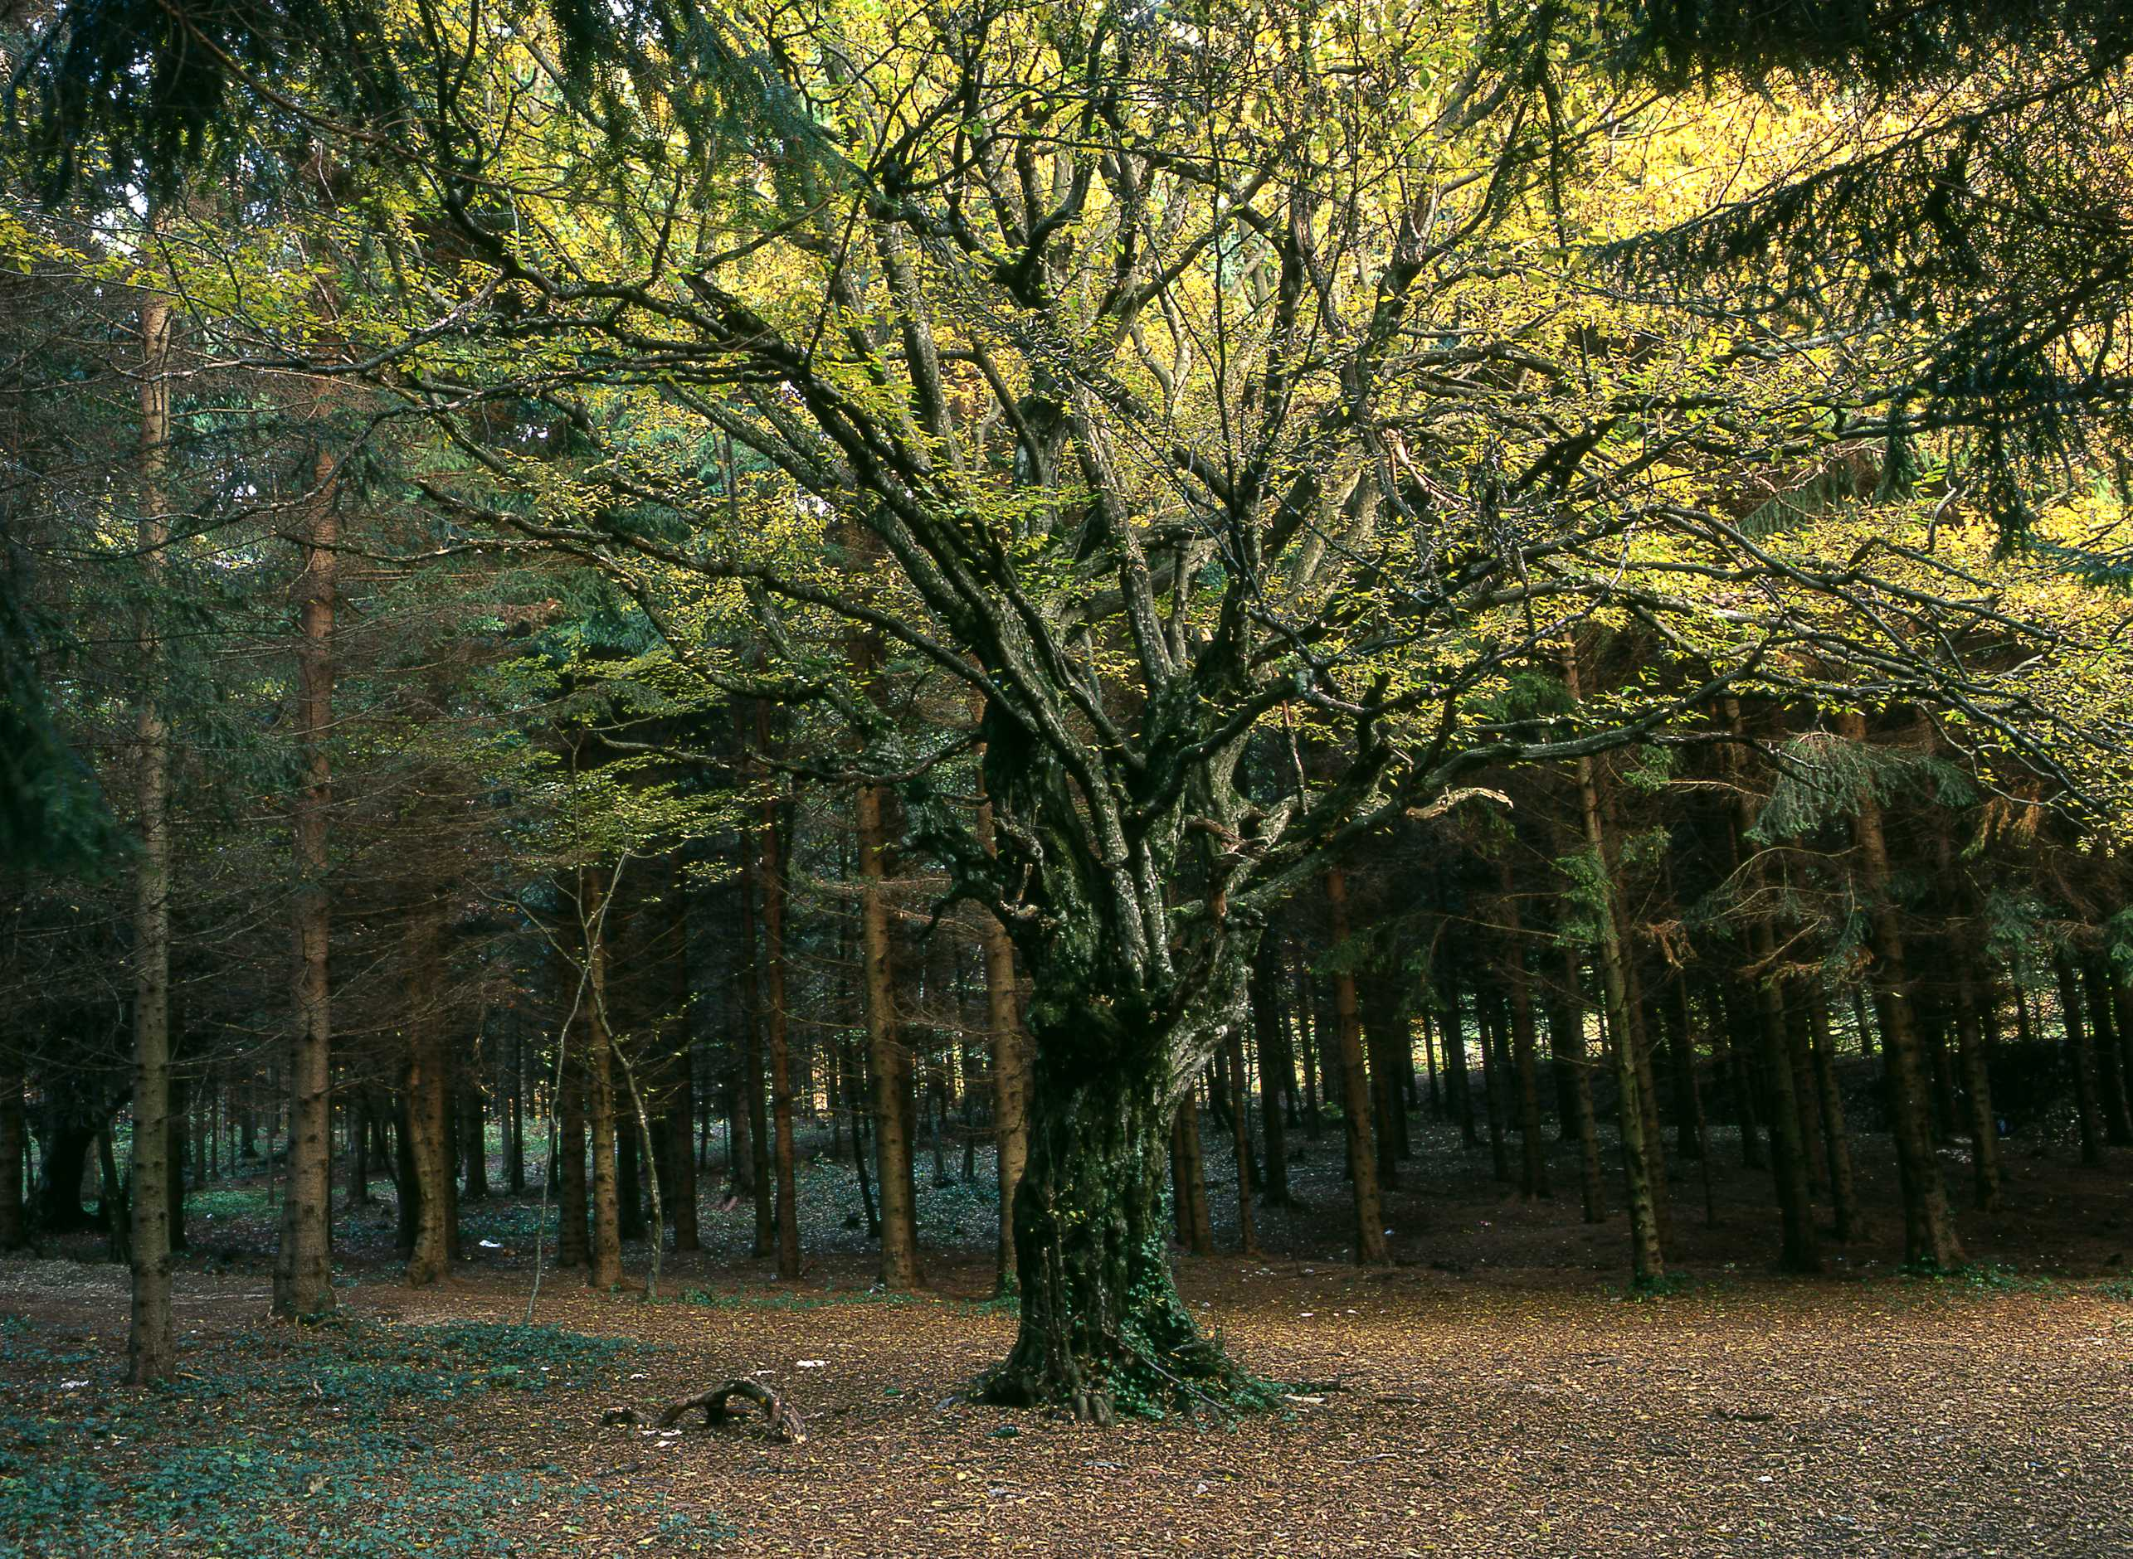
¹⁶ The Lord God commanded him, "You may eat the fruit from any tree in the garden,¹⁷ but you must not eat the fruit from the tree which gives the knowledge of good and evil. If you ever eat fruit from that tree, you will die!"

Slide 13
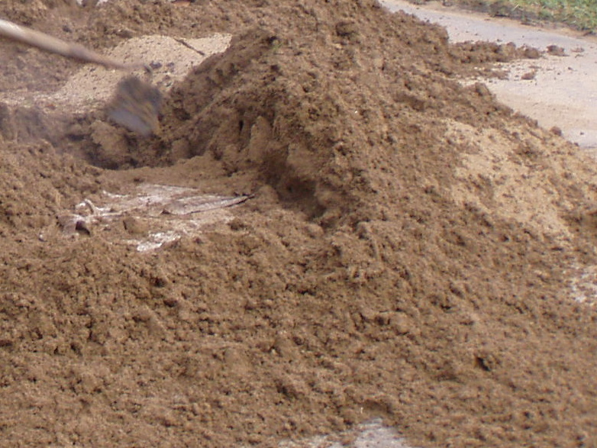
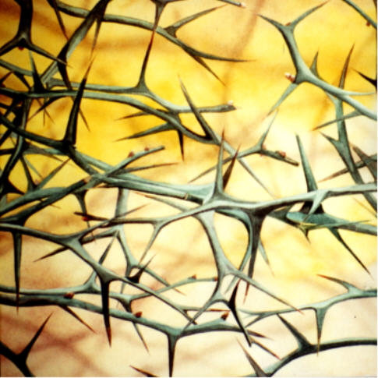

Slide 14
SIN
Shove off God!
I’m in charge!
No to your rules!

Slide 15
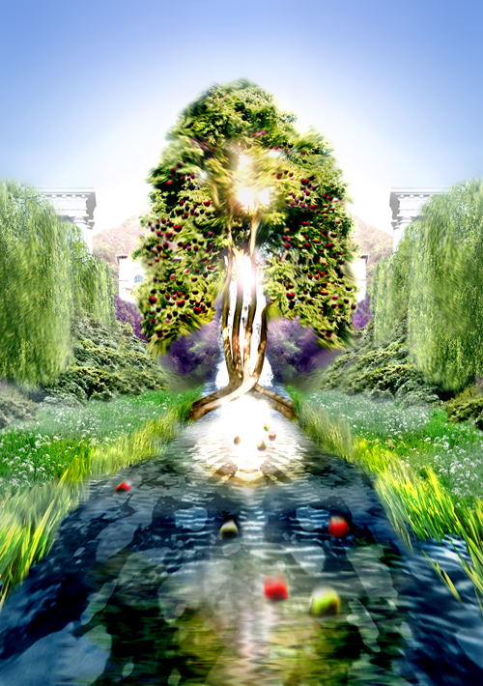
The tree of life was on each side of the river. The leaves of the tree are for the healing of all people.

Slide 16
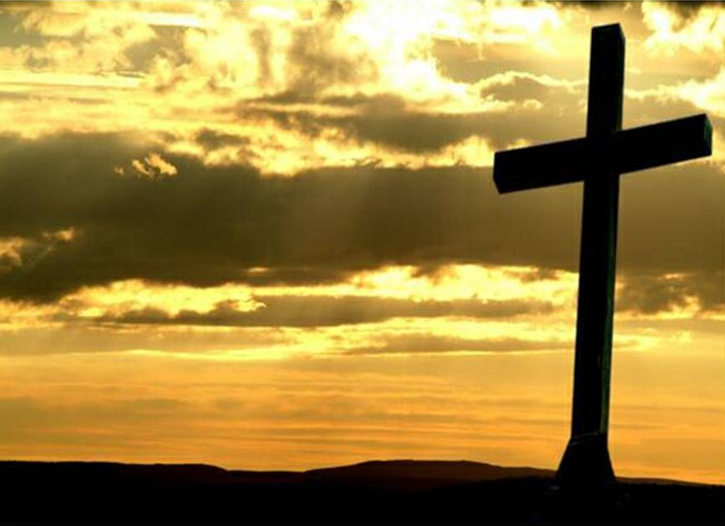
¹⁸ Christ himself suffered for sins once. He was not guilty, but he suffered for those who are guilty to bring you to God.

Slide 17
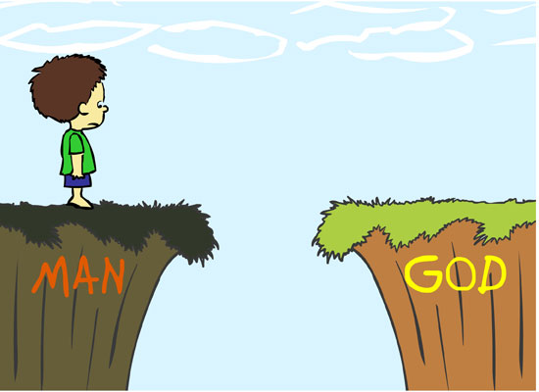
Jesus

Slide 18
There will come a day, The Lord did say, When my people will be made new. I will lead them back to me And they will be made new, And they will be made new.

Slide 19
There will come a day, The Lord did say, When my people will be made new. I’ll forgive their sinfulness And they will be made new, And they will be made new.

Slide 20
There will come a day, The Lord did say, When my people will be made new. I will make them clean and pure And they will be made new, And they will be made new.

Slide 21
There will come a day, The Lord did say, When my people will be made new. Jesus came to seek and save And we have been made new, And we have been made new.

Slide 22
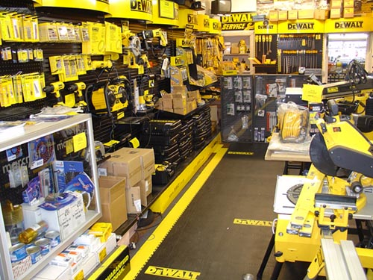
Fixit Factory QUIZ

Slide 23
Workers
Workshops

Slide 24
Workers
DeBrief

Slide 25
“_ _ _ _ _ _ _ _ _ _ _ _ _ _ _ _ _ _ _ _ _ _ _ _ _ _ _ _ _ _ _ _ _ _ , “_ _ _ _ ! _ _ _ _ _ _ _ _ _ _ _ _ _ _ _ _ _ _ _ _ _ _ !".”
_ _ _ _ _ v _

Slide 26
“The One who was sitting on the throne said, "Look! I am making everything new!".”
Rev 21v5

Slide 27
“ _ _ _ _ _ _ _ _ _ _ _ _ _ _ _ _ _ _ _ ! _ _ _ _ _ _ _ _ _ _ _ _ _ _ _ _ _ _ _ _ _ _ _ _ _ _ ".”
_ _ _ _ _ v _ _

Slide 28
“What kind of man is this! Even the wind and waves obey Him".”
Mark 4v41

Slide 29
“The tree of life was on both sides of the river. It’s leaves are for the healing of all people.”
Rev 22v2

Slide 30
“The _ _ _ _ of _ _ _ _ was on both _ _ _ _ _ of the river. It’s _ _ _ _ _ _ are for the healing of all _ _ _ _ _ _ .”
Rev 22v2

Slide 31
“The _ _ _ _ of _ _ _ _ was on _ _ _ _ _ _ _ _ _ of the _ _ _ _ _ . It’s _ _ _ _ _ _ are _ _ _ the _ _ _ _ _ _ _ of all _ _ _ _ _ _ .”
_ _ _ 22v _

Slide 32
“_ _ _ _ _ _ _ _ _ _ _ _ _ _ _ _ _ _ _ _ _ _ _ _ _ _ _ _ _ _ _ _ _ _ _ _ _ . _ _ ’_ _ _ _ _ _ _ _ _ _ _ _ _ _ _ _ _ _ _ _ _ _ _ _ _ _ _ _ _ _ _ _ _ _ _ .”
_ _ _ _ _ v _

Slide 33
“The tree of life was on both sides of the river. It’s leaves are for the healing of all people.”
Rev 22v2

Slide 34
Who’s the King of the jungle? “OOO OOO” Who’s the King of the sea? “Bubble, bubble, bubble” Who’s the King of the universe? And who’s the King of me?

Slide 35
I’ll tell you . . . . . J – E – S – U – S Yes! He’s the King of me! He’s the King of the universe, the jungle and the sea! “Bubble, bubble, bubble . . . . OOO OOO!”

Slide 36
Clocking out!

Slide 38
Workers
Lunch

Slide 39
Daily Summary

Slide 40
“_ _ _ _ _ _ _ _ _ _ _ _ _ _ _ _ _ _ _ _ _ _ _ _ _ _ _ _ _ _ _ _ _ _ _ _ _ . _ _ ’_ _ _ _ _ _ _ _ _ _ _ _ _ _ _ _ _ _ _ _ _ _ _ _ _ _ _ _ _ _ _ _ _ _ _ .”
_ _ _ _ _ v _

Slide 41
“The tree of life was on both sides of the river. It’s leaves are for the healing of all people.”
Rev 22v2

Slide 42
“ _ _ _ _ _ _ _ _ _ _ _ _ _ _ _ _ _ _ _ _ _ _ _ _ _ _ _ _ _ _ _ _ _ _ , “_ _ _ _ ! _ _ _ _ _ _ _ _ _ _ _ _ _ _ _ _ _ _ _ _ _ _ !".”
_ _ _ _ _ v _

Slide 43
“The One who was sitting on the throne said, "Look! I am making everything new!".”
Rev 21v5

Slide 44
“ _ _ _ _ _ _ _ _ _ _ _ _ _ _ _ _ _ _ _ ! _ _ _ _ _ _ _ _ _ _ _ _ _ _ _ _ _ _ _ _ _ _ _ _ _ _ ".”
_ _ _ _ _ v _ _

Slide 45
“What kind of man is this! Even the wind and waves obey Him".”
Mark 4v41

Slide 46
He is the world creating, always speaking, Sin forgiving, people freeing Strong and Mighty, so amazing God Repeat

Slide 47
He rescues us from sin He calls and lead us on To show how much He loves us He sent His precious son

Slide 48
He is the world creating, always speaking, Sin forgiving, people freeing Strong and Mighty, so amazing God Repeat

Slide 49
So Jesus came to earth to live and then to die Though people crucified Him He rose to life on high

Slide 50
He is the world creating, always speaking, Sin forgiving, people freeing Strong and Mighty, so amazing God Repeat

Slide 51
God sends his Holy Spirit to be with us each day To help us live like Jesus and follow in His way

Slide 52
He is the world creating, always speaking, Sin forgiving, people freeing Strong and Mighty, so amazing God Repeat

Slide 53
Clocking out!

Slide 54
Almighty Creator
You spoke and there was light
There was light
And by Your great power
You spoke and there was day
And there was night
And you made all things to show Your glory
Formed all things to bring You praise

Slide 55
And You’ve created me to worship You
And You’ve created me to love You
And You’ve made me to delight in You
All glory to Your name

Slide 56
The mountains, the oceans
All creatures great and small
In the earth
All nations, all peoples
Of all colours came to be
By Your word
And You shed your blood for our salvation
So You could make us anew

Slide 57
And You’ve created me to worship You
And You’ve created me to love You
And You’ve made me to delight in You
All glory to Your name

