Slide 1
Welcome to . . . .
St Mary’s,
Holiday Bible Club 2013

Slide 2
Have you ever wondered how the God who made the universe,
And all the plants and creatures that you have ever seen,
The planets, stars, the moon and sun, is watching over everyone,
And still has time for tiny little me.

Slide 3
My God made crocodiles and antelopes, jellyfish and billy goats,
Elephants and spiders and buffaloes and bees,
Rattlesnakes and porcupines and ladybirds and butterflies,
And still has time for tiny little me.

Slide 4
My God made deserts dry and mountains tall, jungle vines and waterfalls,
All kinds of places where I have never been,
Forests green and oceans wide, the wind and rain, the sea and sky,
And still has time for tiny little me.

Slide 5
My God made mums and dads and great grandmothers,
Aunties, uncles and stepbrothers,
All the different people who are in my family,
Grandads, sisters, babies too and second cousins twice removed,
And still has time for tiny little me.

Slide 6
Workers
Briefing

Slide 7
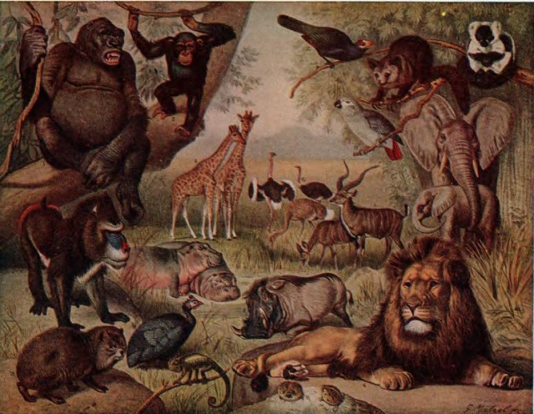
^{Genesis 1v20-25}

Slide 8
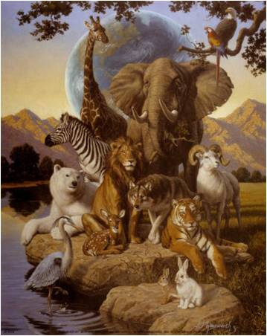
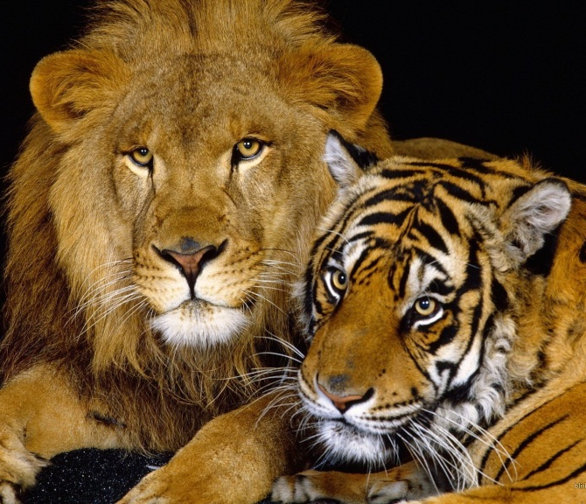
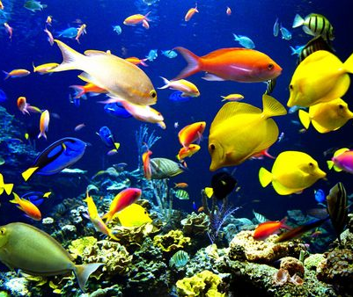
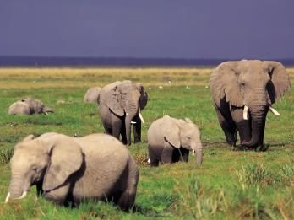
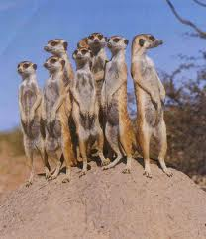
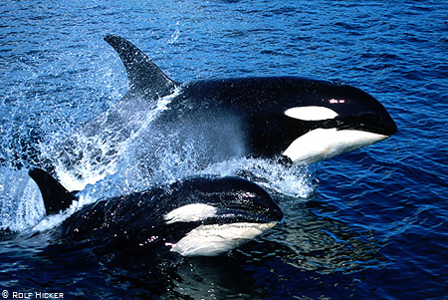
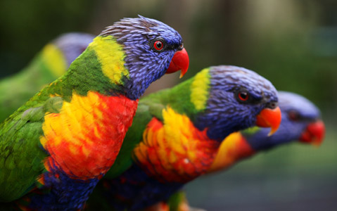
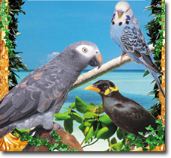
³¹ God looked at everything He had made, and it was very good.

Slide 9
Day one God’s work begun: The light and dark He made apart. Day two Still more to do. The sky and sea Were made to be.

Slide 10
And it was good, Just as it should. As all creation God did form By the power of His word, The power of His word.

Slide 11
Day three Came plants and trees, As by His hand God made the land. Day four God still made more: The moon for night And sun for light.

Slide 12
And it was good, Just as it should. As all creation God did form By the power of His word, The power of His word.

Slide 13
Day five Birds filled the skies And God decreed Fish for the seas. Day six Came living things, Including man To work the land.

Slide 14
And it was good, Just as it should. As all creation God did form By the power of His word, The power of His word.

Slide 15
Then came The seventh day When God did rest And called it blessed.

Slide 16
And it was good, Just as it should. As all creation God did form By the power of His word, The power of His word.

Slide 17
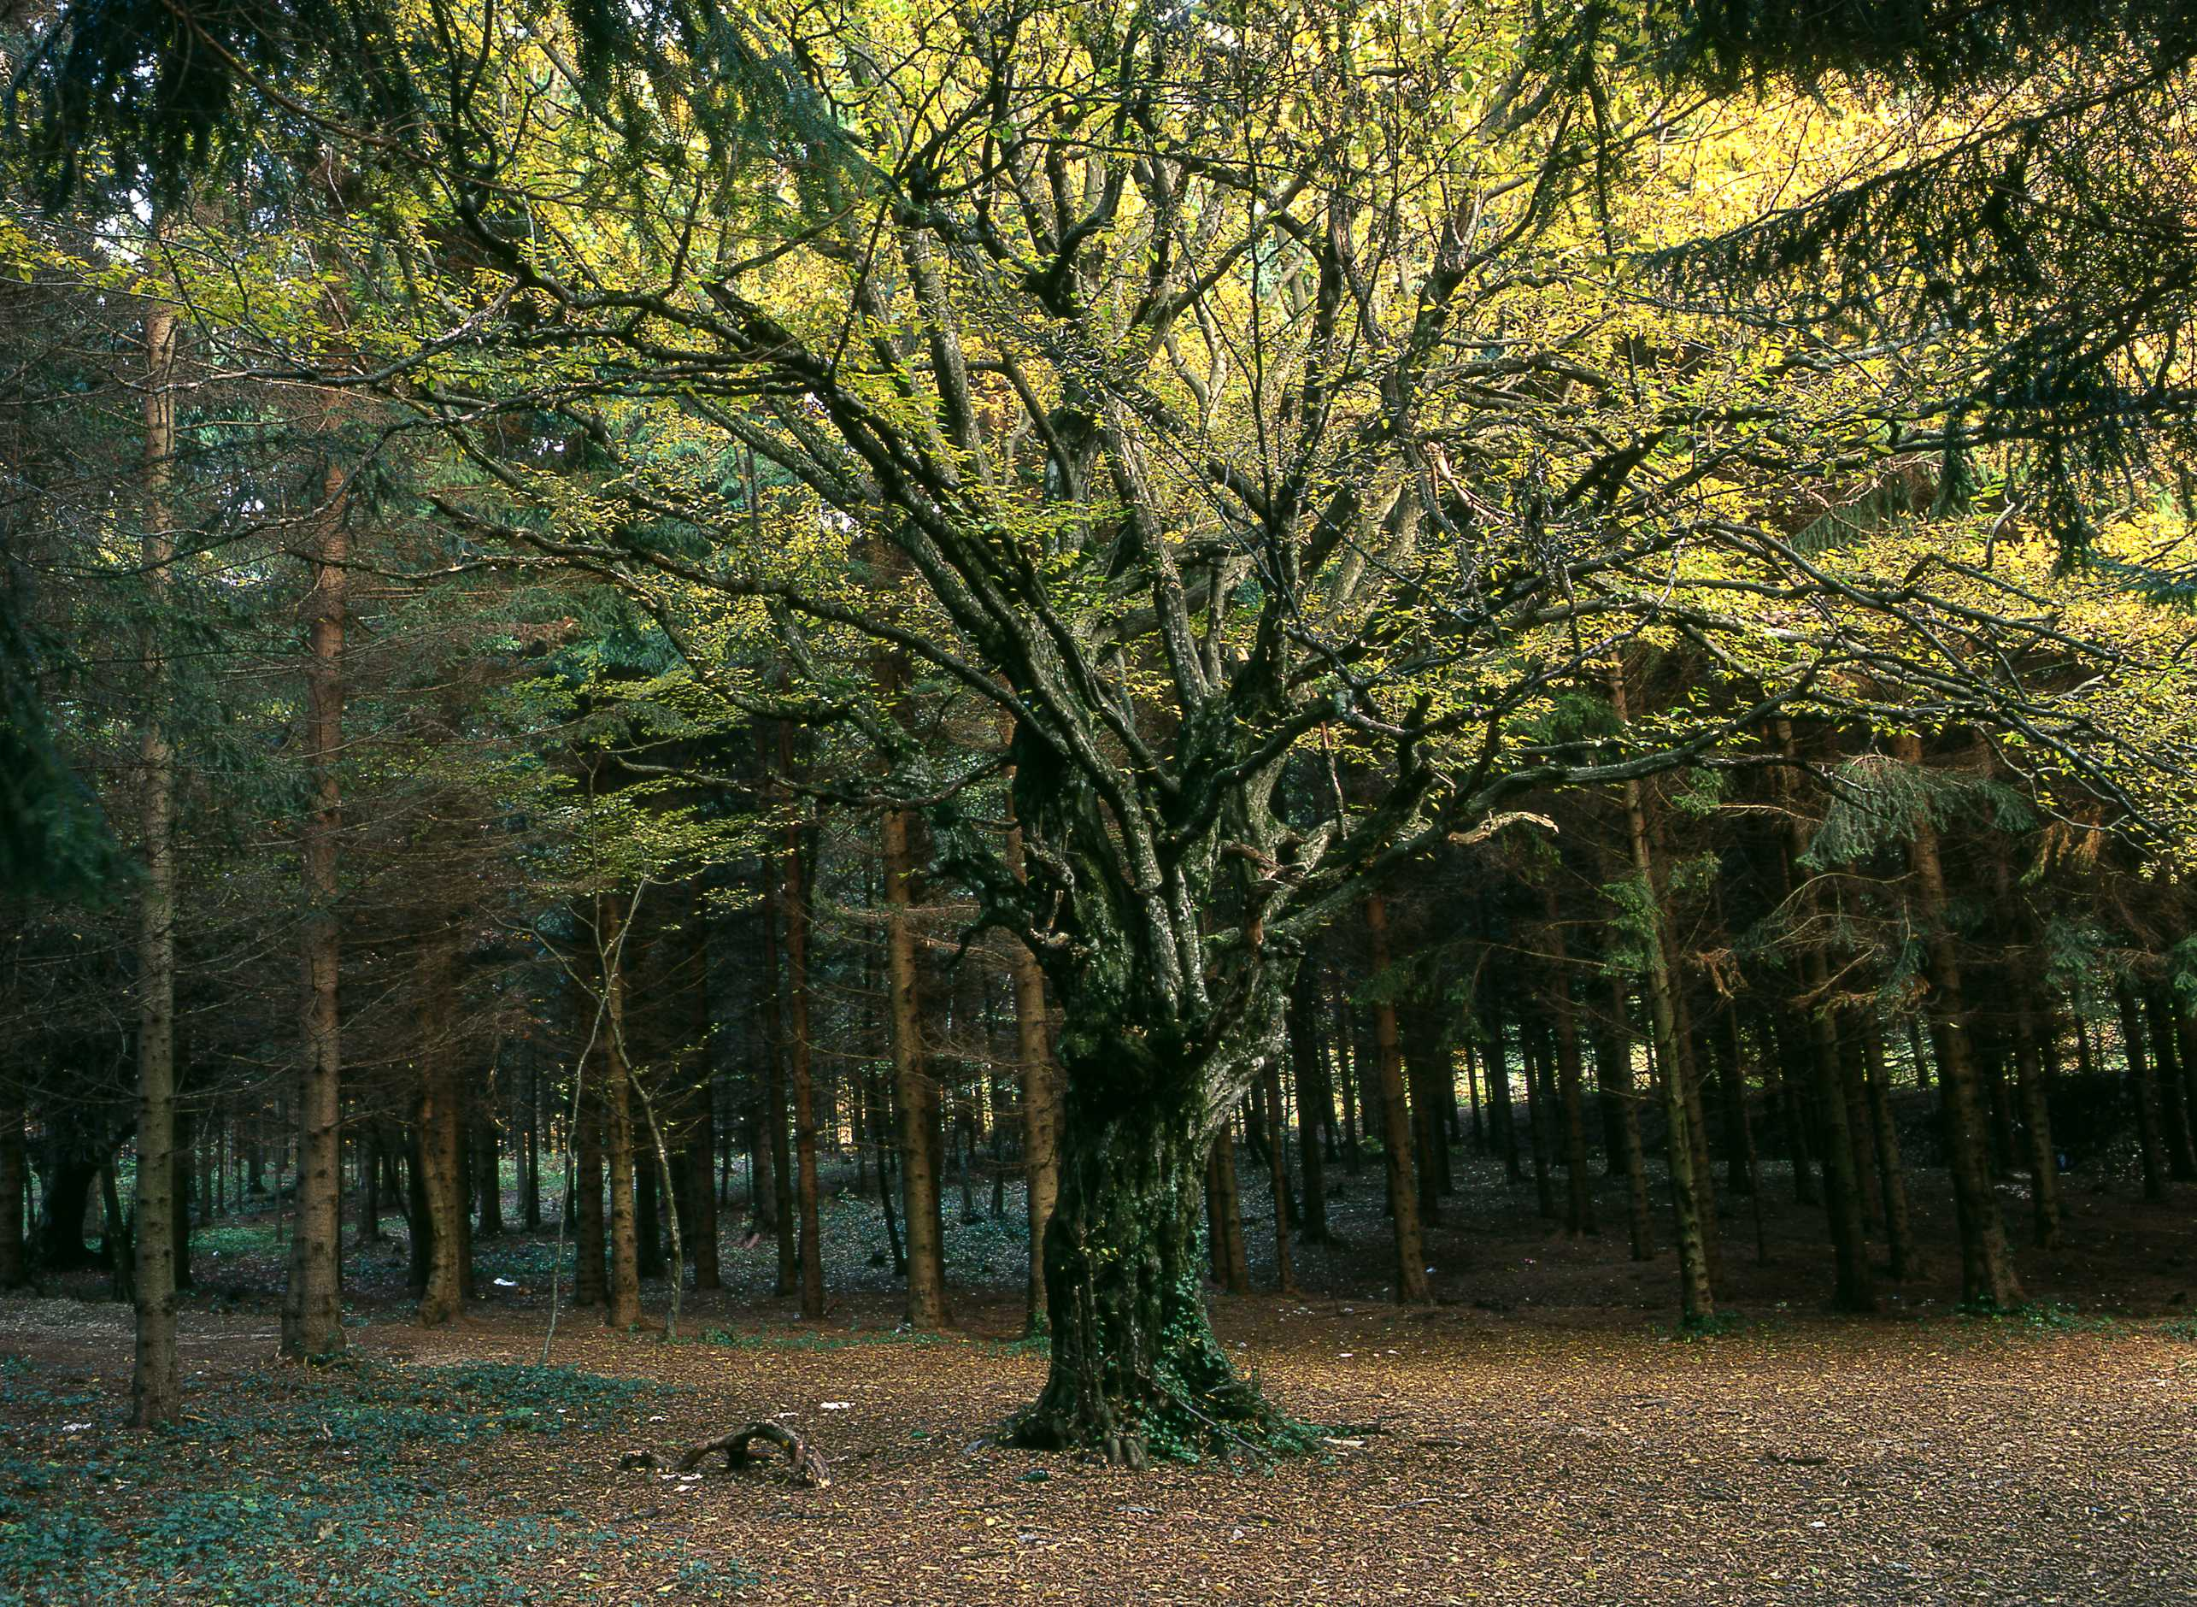
¹⁶ The Lord God commanded him, "You may eat the fruit from any tree in the garden,¹⁷ but you must not eat the fruit from the tree which gives the knowledge of good and evil. If you ever eat fruit from that tree, you will die!"

Slide 18
SIN
Shove off God!
I’m in charge!
No to your rules!

Slide 19
Then wolves will live in peace with lambs,
and leopards will lie down to rest with goats.
Calves, lions, and young bulls will eat together,
and a little child will lead them.
7 Cows and bears will eat together in peace.
Their young will lie down to rest together.
Lions will eat hay as oxen do.
8 A baby will be able to play near a cobra's hole,
and a child will be able to put his hand into the nest of a poisonous snake.
9 They will not hurt or destroy each other
on all my holy mountain,
because the earth will be full of the knowledge of the Lord,
as the sea is full of water.

Slide 20
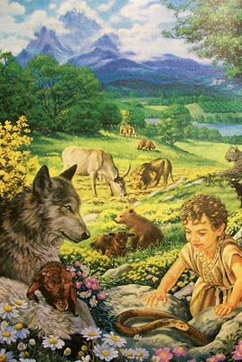
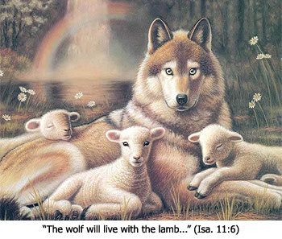
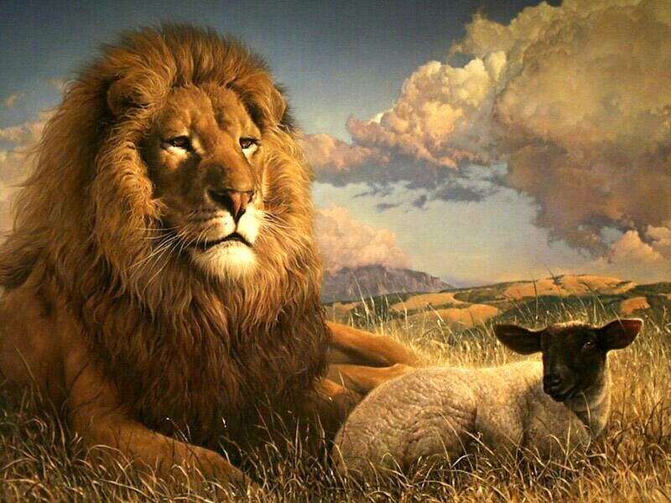

Slide 21
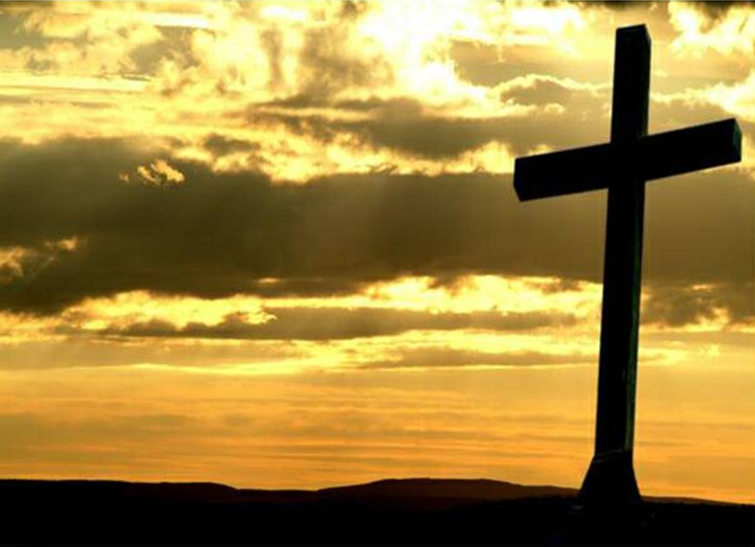
¹⁸ Christ himself suffered for sins once. He was not guilty, but he suffered for those who are guilty to bring you to God.

Slide 22
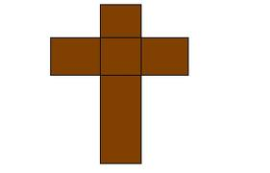
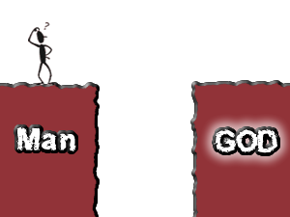

Slide 23
He is the world creating, always speaking, Sin forgiving, people freeing Strong and Mighty, so amazing God Repeat

Slide 24
He rescues us from sin He calls and lead us on To show how much he loves us He sent his precious son

Slide 25
He is the world creating, always speaking, Sin forgiving, people freeing Strong and Mighty, so amazing God Repeat

Slide 26
So Jesus came to earth To live and then to die Though people crucified Him He rose to life on high

Slide 27
He is the world creating, always speaking, Sin forgiving, people freeing Strong and Mighty, so amazing God Repeat

Slide 28
God sends his holy spirit to be with us each day To help us live like Jesus and follow in his way

Slide 29
He is the world creating, always speaking, Sin forgiving, people freeing Strong and Mighty, so amazing God Repeat

Slide 30
Workers
Workshops

Slide 31
Workers
DeBrief

Slide 32
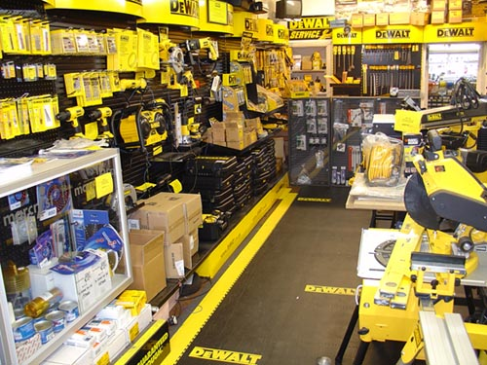
Fixit Factory QUIZ

Slide 33
“Then wolves will live in peace with lambs, and leopards will lie down to rest with goats.”
Isaiah 11v6

Slide 34
“Then _ _ _ _ _ _ will live in _ _ _ _ _ with lambs, and _ _ _ _ _ _ _ _ will _ _ _ down to rest with _ _ _ _ _ .”
Isaiah _ _ v6

Slide 35
“Then _ _ _ _ _ _ will _ _ _ _ in _ _ _ _ _ with _ _ _ _ _ , and _ _ _ _ _ _ _ _ will _ _ _ _ _ _ _ to _ _ _ _ with _ _ _ _ _ .”
_ _ _ _ _ _ _ _ v _

Slide 36
“_ _ _ _ _ _ _ _ _ _ _ _ _ _ _ _ _ _ _ _ _ _ _ _ _ _ _ _ _ _ _ _ _ _ , _ _ _ _ _ _ _ _ _ _ _
_ _ _ _ _ _ _ _ _ _ _ _ _ _ _ _ _ _ _ _ _ _ _ _ _ _ .”
_ _ _ _ _ _ _ _ v _

Slide 37
“Then wolves will live in peace with lambs, and leopards will lie down to rest with goats.”
Isaiah 11v6

Slide 38
There will come a day, The Lord did say, When my people will be made new. I will lead them back to me And they will be made new, And they will be made new.

Slide 39
There will come a day, The Lord did say, When my people will be made new. I’ll forgive their sinfulness And they will be made new, And they will be made new.

Slide 40
There will come a day, The Lord did say, When my people will be made new. I will make them clean and pure And they will be made new, And they will be made new.

Slide 41
There will come a day, The Lord did say, When my people will be made new. Jesus came to seek and save And we have been made new, And we have been made new.

Slide 42
Workers
Lunch

Slide 43
Daily Summary

Slide 44
“ _ _ _ _ _ _ _ _ _ _ _ _ _ _ _ _ _ _ _ _ _ _ _ _ _ _ _ _ _ _ _ _ _ _ , “_ _ _ _ ! _ _ _ _ _ _ _ _ _ _ _ _ _ _ _ _ _ _ _ _ _ _ !".”
_ _ _ _ _ v _

Slide 45
“The One who was sitting on the throne said, "Look! I am making everything new!".”
Rev 21v5

Slide 46
“ _ _ _ _ _ _ _ _ _ _ _ _ _ _ _ _ _ _ _ ! _ _ _ _ _ _ _ _ _ _ _ _ _ _ _ _ _ _ _ _ _ _ _ _ _ _ ".”
_ _ _ _ _ v _ _

Slide 47
“What kind of man is this! Even the wind and waves obey Him".”
Mark 4v41

Slide 48
“_ _ _ _ _ _ _ _ _ _ _ _ _ _ _ _ _ _ _ _ _ _ _ _ _ _ _ _ _ _ _ _ _ _ _ _ _ . _ _ ’_ _ _ _ _ _ _ _ _ _ _ _ _ _ _ _ _ _ _ _ _ _ _ _ _ _ _ _ _ _ _ _ _ _ _ .”
_ _ _ _ _ v _

Slide 49
“The tree of life was on both sides of the river. It’s leaves are for the healing of all people.”
Rev 22v2

Slide 50
“_ _ _ _ _ _ _ _ _ _ _ _ _ _ _ _ _ _ _ _ _ _ _ _ _ _ _ _ _ _ _ _ _ _ , _ _ _ _ _ _ _ _ _ _ _
_ _ _ _ _ _ _ _ _ _ _ _ _ _ _ _ _ _ _ _ _ _ _ _ _ _ .”
_ _ _ _ _ _ _ _ v _

Slide 51
“Then wolves will live in peace with lambs, and leopards will lie down to rest with goats.”
Isaiah 11v6

Slide 52
He is the world creating, always speaking, Sin forgiving, people freeing Strong and Mighty, so amazing God Repeat

Slide 53
He rescues us from sin He calls and lead us on To show how much He loves us He sent His precious son

Slide 54
He is the world creating, always speaking, Sin forgiving, people freeing Strong and Mighty, so amazing God Repeat

Slide 55
So Jesus came to earth to live and then to die Though people crucified Him He rose to life on high

Slide 56
He is the world creating, always speaking, Sin forgiving, people freeing Strong and Mighty, so amazing God Repeat

Slide 57
God sends his Holy Spirit to be with us each day To help us live like Jesus and follow in His way

Slide 58
He is the world creating, always speaking, Sin forgiving, people freeing Strong and Mighty, so amazing God Repeat

Slide 59
Clocking out!

Slide 60
Almighty Creator
You spoke and there was light
There was light
And by Your great power
You spoke and there was day
And there was night
And you made all things to show Your glory
Formed all things to bring You praise

Slide 61
And You’ve created me to worship You
And You’ve created me to love You
And You’ve made me to delight in You
All glory to Your name

Slide 62
The mountains, the oceans
All creatures great and small
In the earth
All nations, all peoples
Of all colours came to be
By Your word
And You shed your blood for our salvation
So You could make us anew

Slide 63
And You’ve created me to worship You
And You’ve created me to love You
And You’ve made me to delight in You
All glory to Your name

