Slide 1
Welcome to . . . .
St John’s,
Holiday Bible Club 2012

Slide 2
From the Highest of Heights
to the depths of the sea,
creation’s revealing your majesty.
From the colours of fall
to the fragrance of spring,
every creature unique
in the song that it sings.
All exclaiming:
CCL5740

Slide 3
Indescribable, uncontainable,
you placed the stars in the sky,
and you know them by name:
you are amazing God.
All powerful, untameable;
awestruck, we fall to our knees
as we humbly proclaim:
you are amazing, God.
CCL5740

Slide 4
Who has told every lightning bolt
where it should go,
or seen heavenly storehouses
laden with snow?
Who imagined the sun and
gives source to its light,
yet conceals it to bring us the
coolness of night?
None can fathom:
CCL5740

Slide 5
Indescribable, uncontainable,
you placed the stars in the sky,
and you know them by name:
you are amazing God.
All powerful, untameable;
awestruck, we fall to our knees
as we humbly proclaim:
you are amazing, God.
CCL5740

Slide 6
Indescribable, uncontainable,
you placed the stars in the sky,
and you know them by name:
you are amazing God.
Incomparable, unchangeable,
you see the depths of my heart
and you love me the same,
you are amazing, God.
Laura Story, add, lyrics Jesse Reeves. 2004. worshiptogether.com. CCL5740

Slide 8
Have you ever wondered how the God who made the universe,
And all the plants and creatures that you have ever seen,
The planets, stars, the moon and sun, is watching over everyone,
And still has time for tiny little me.

Slide 9
My God made crocodiles and antelopes, jellyfish and billy goats,
Elephants and spiders and buffaloes and bees,
Rattlesnakes and porcupines and ladybirds and butterflies,
And still has time for tiny little me.

Slide 10
My God made deserts dry and mountains tall, jungle vines and waterfalls,
All kinds of places where I have never been,
Forests green and oceans wide, the wind and rain, the sea and sky,
And still has time for tiny little me.

Slide 11
My God made mums and dads and great grandmothers,
Aunties, uncles and stepbrothers,
All the different people who are in my family,
Grandads, sisters, babies too and second cousins twice removed,
And still has time for tiny little me.

Slide 13
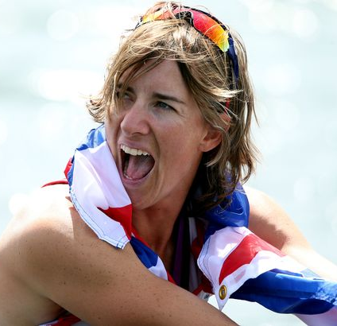
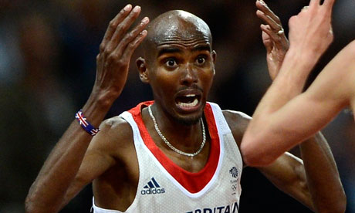
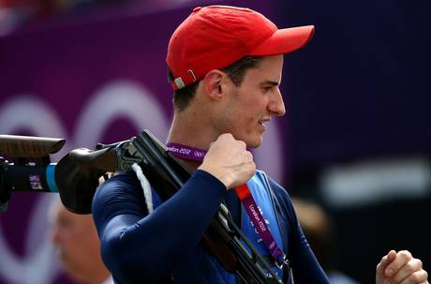
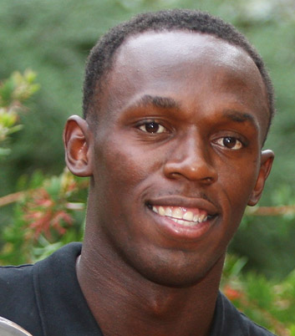
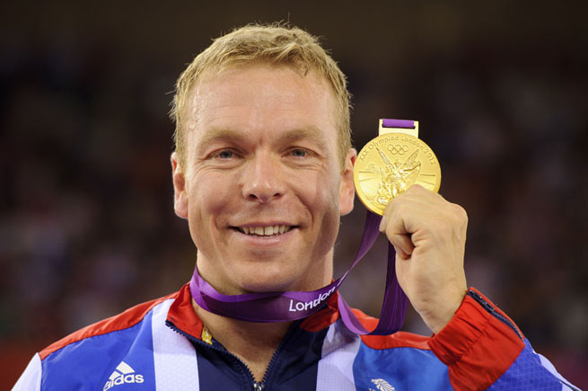
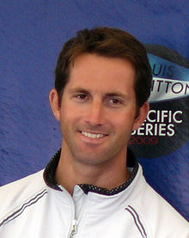
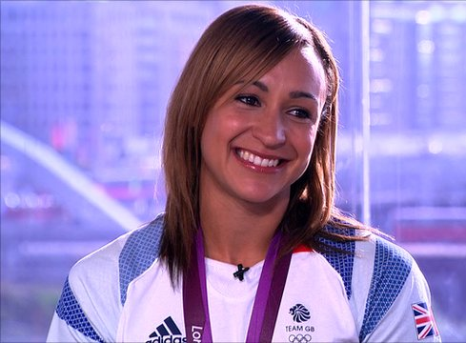

Slide 14
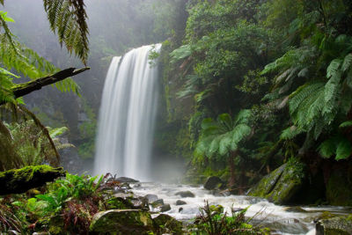
Genesis 1 v 26-29

Slide 15
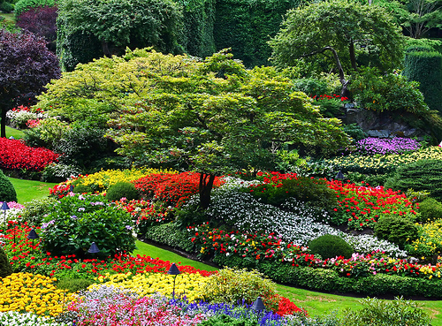
³¹ God looked at everything He had made, and it was very good.

Slide 16
Day one God’s work begun: The light and dark He made apart. Day two Still more to do. The sky and sea Were made to be.

Slide 17
And it was good, Just as it should. As all creation God did form By the power of His word, The power of His word.

Slide 18
Day three Came plants and trees, As by His hand God made the land. Day four God still made more: The moon for night And sun for light.

Slide 19
And it was good, Just as it should. As all creation God did form By the power of His word, The power of His word.

Slide 20
Day five Birds filled the skies And God decreed Fish for the seas. Day six Came living things, Including man To work the land.

Slide 21
And it was good, Just as it should. As all creation God did form By the power of His word, The power of His word.

Slide 22
Then came The seventh day When God did rest And called it blessed.

Slide 23
And it was good, Just as it should. As all creation God did form By the power of His word, The power of His word.

Slide 24
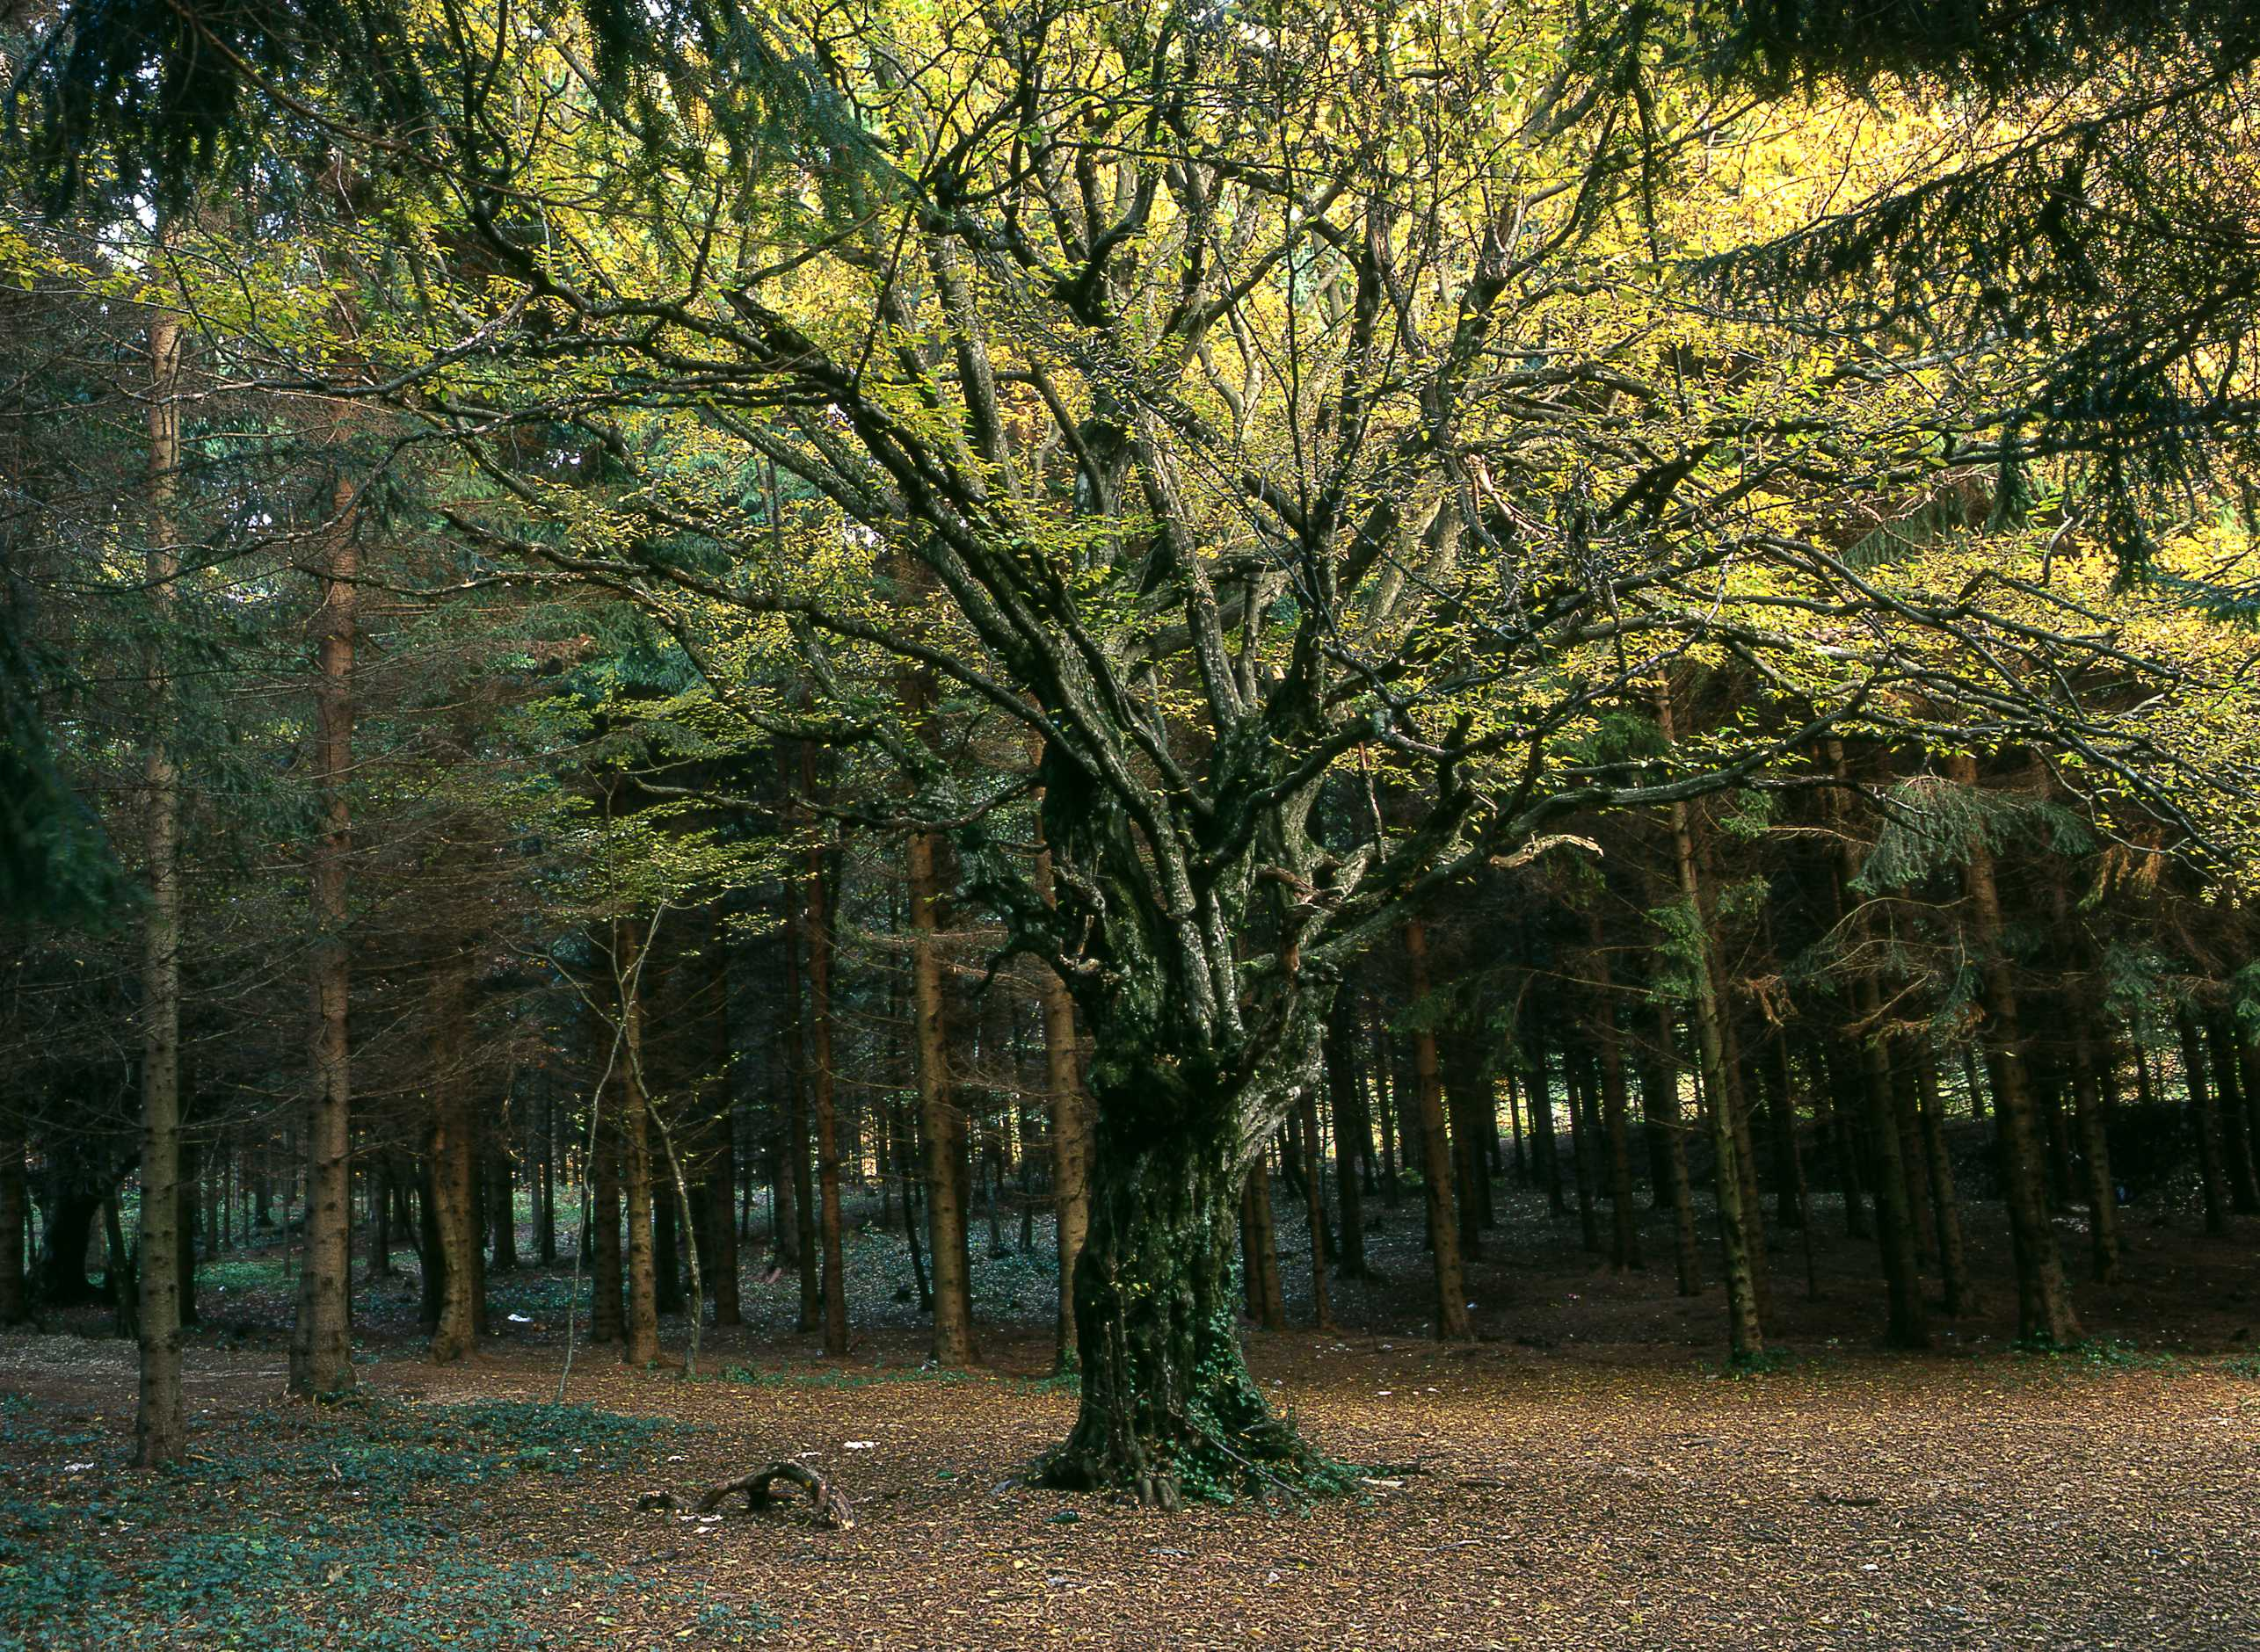
¹⁶ The Lord God commanded him, "You may eat the fruit from any tree in the garden,¹⁷ but you must not eat the fruit from the tree which gives the knowledge of good and evil. If you ever eat fruit from that tree, you will die!"

Slide 25
SIN
Shove off God!
I’m in charge!
No to your rules!

Slide 26
26 I will give you a new heart and put a new spirit in you; I will remove from you your heart of stone and give you a heart of flesh. 27 And I will put my Spirit in you and move you to follow my decrees and be careful to keep my laws.

Slide 27
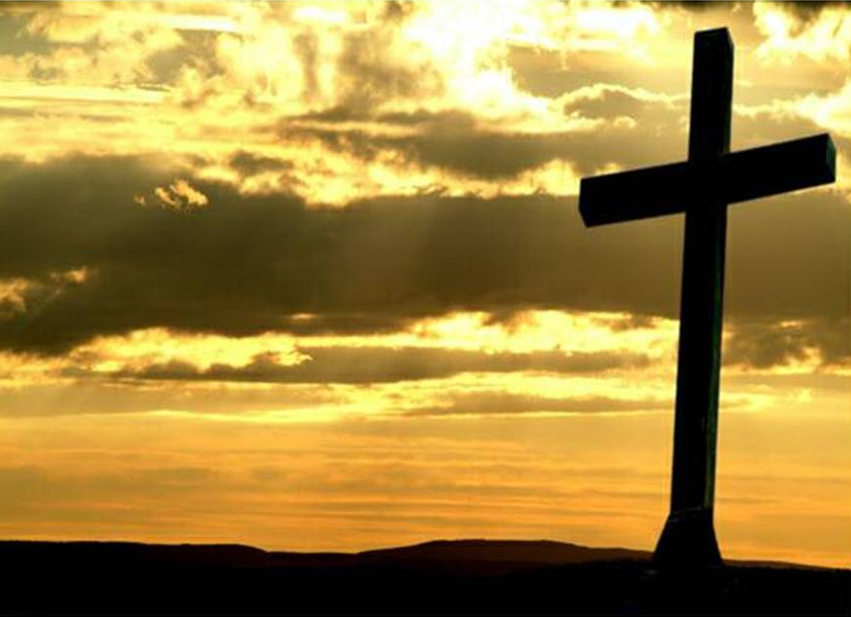
¹⁸ Christ himself suffered for sins once. He was not guilty, but he suffered for those who are guilty to bring you to God.

Slide 28
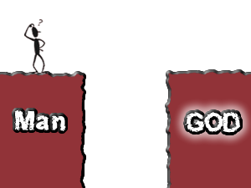

Slide 29
He is the world creating, always speaking, Sin forgiving, people freeing Strong and Mighty, so amazing God Repeat

Slide 30
He rescues us from sin He calls and lead us on To show how much he loves us He sent his precious son

Slide 31
He is the world creating, always speaking, Sin forgiving, people freeing Strong and Mighty, so amazing God Repeat

Slide 32
So Jesus came to earth To live and then to die Though people crucified Him He rose to life on high

Slide 33
He is the world creating, always speaking, Sin forgiving, people freeing Strong and Mighty, so amazing God Repeat

Slide 34
God sends his holy spirit to be with us each day To help us live like Jesus and follow in his way

Slide 35
He is the world creating, always speaking, Sin forgiving, people freeing Strong and Mighty, so amazing God Repeat

Slide 37
Fixit Factory QUIZ

Slide 38
There will come a day, The Lord did say, When my people will be made new. I will lead them back to me And they will be made new, And they will be made new.

Slide 39
There will come a day, The Lord did say, When my people will be made new. I’ll forgive their sinfulness And they will be made new, And they will be made new.

Slide 40
There will come a day, The Lord did say, When my people will be made new. I will make them clean and pure And they will be made new, And they will be made new.

Slide 41
There will come a day, The Lord did say, When my people will be made new. Jesus came to seek and save And we have been made new, And we have been made new.

Slide 43
Coffee & photos
Activities on
the lawn
followed by BBQ
Prayer Breakfast
Coffee & croissants
next Sat 8.30am church rooms
Sunday Seekers & Pathfinders start next week
Women’s comedy night with Abby Guinness
8pm Sat 15th Sept
Tickets £10

Slide 44
You’re the Word of God the Father,
From before the world began,
Every star and every planet,
Has been fashioned by Your hand,
All creation holds together
By the power of your voice;
Let the skies declare your glory,
Let the land and seas rejoice!

Slide 45
You’re the Author of Creation,
You’re the Lord of every man,
And your cry of love rings out across the lands

Slide 46
Yet you left the gaze of angels,
Came to seek and save the lost,
And exchanged the joy of heaven
For the anguish of a cross.
With a prayer you fed the hungry,
With a word you stilled the sea.
Yet how silently you suffered
That the guilty may go free.

Slide 47
You’re the Author of Creation,
You’re the Lord of every man,
And your cry of love rings out across the lands

Slide 48
With a shout you rose victorious,
Wrestling victory from the grave.
And ascended into heaven
Leading captives in your wake.
Now you stand before the Father
Interceding for your own.
From each tribe and tongue and nation
You are leading sinners home.

Slide 49
You’re the Author of Creation,
You’re the Lord of every man,
And your cry of love rings out across the lands
CCL 5740

Slide 50
Thank you for coming to Welcome to . . . .
St John’s, HBC

