Slide 1
Welcome to . . . .
St Mary’s,
Holiday Bible Club 2013

Slide 2
Workers
Training

Slide 3
Made
Broken
Fixed

Slide 4
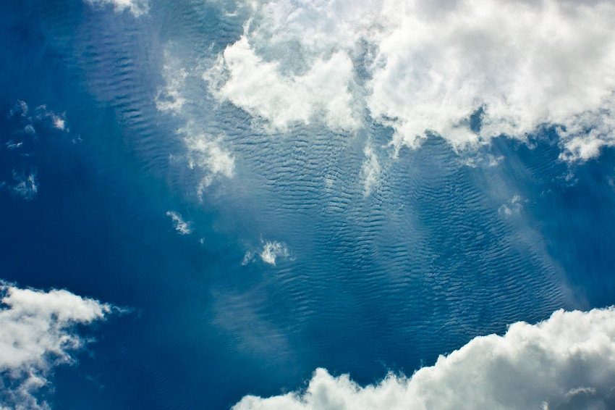
The Beginning of the World
¹ In the beginning God created the sky and the earth.

Slide 5
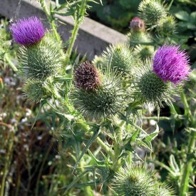

Slide 6
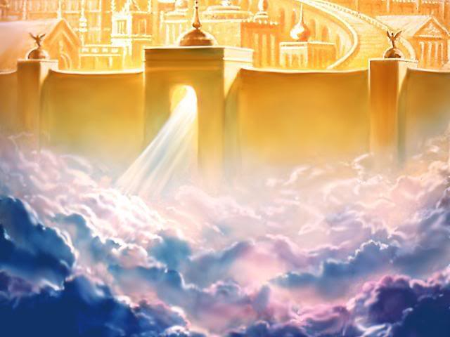
The New Jerusalem
¹ Then I saw a new heaven and a new earth. The first heaven and the first earth had disappeared.

Slide 7
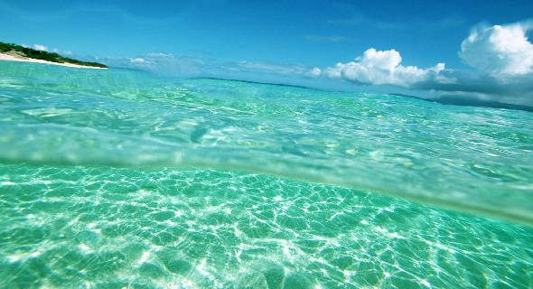
9 Then God said, "Let the water under the sky be gathered together so the dry land will appear." And it happened.10 God named the dry land "earth" and the water that was gathered together "seas."

Slide 8
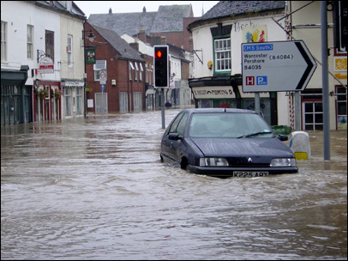
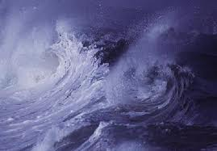
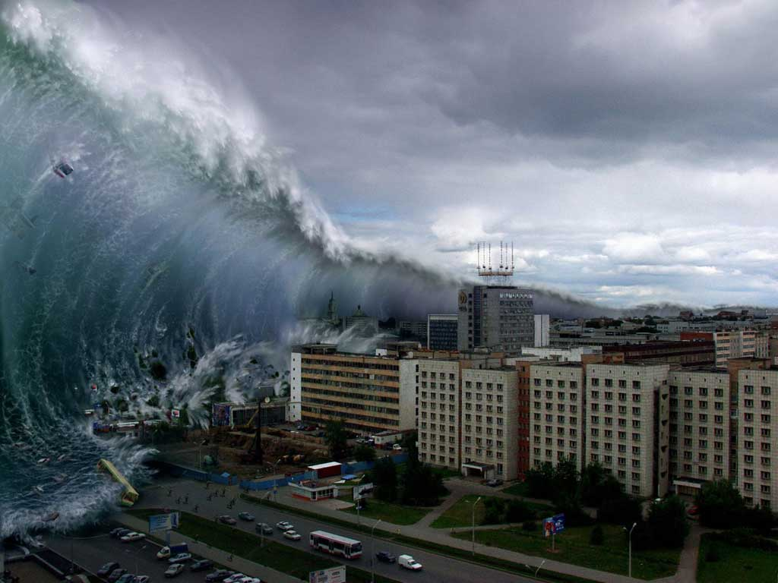
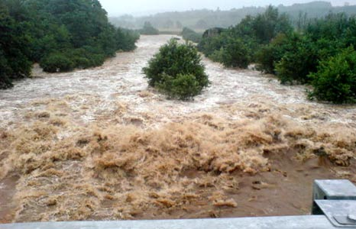

Slide 9
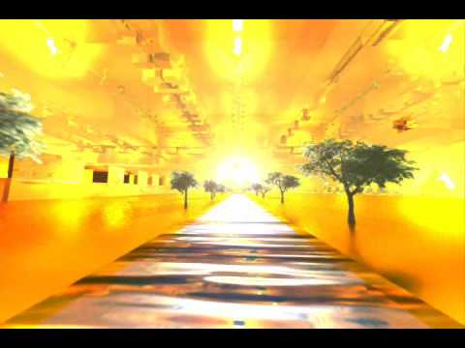
¹ Then the angel showed me the river of the water of life. It was shining like crystal and was flowing from the throne of God and of the Lamb² down the middle of the street of the city.

Slide 10
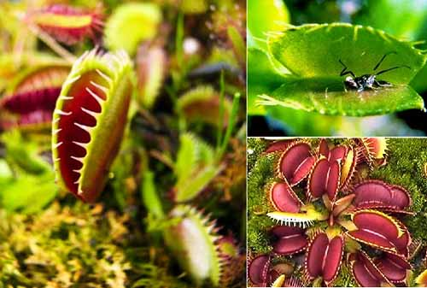
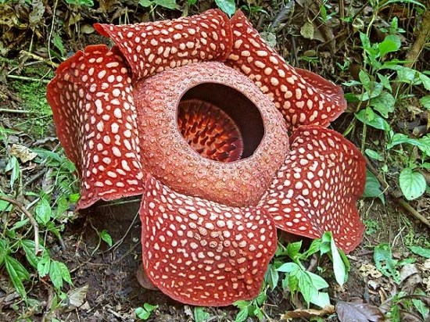
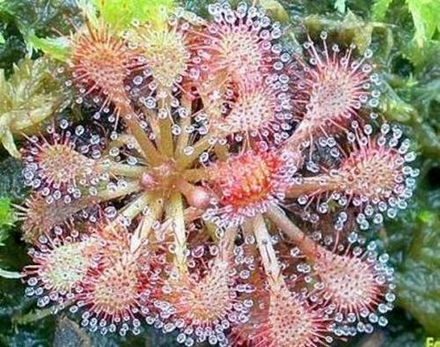
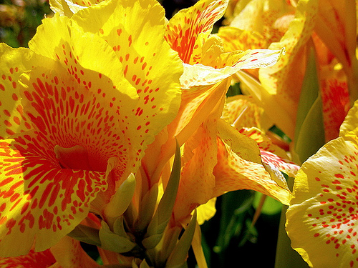

Slide 11
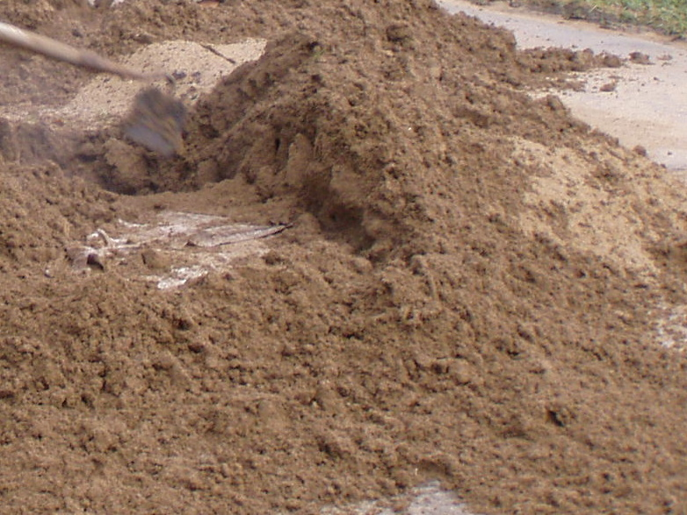
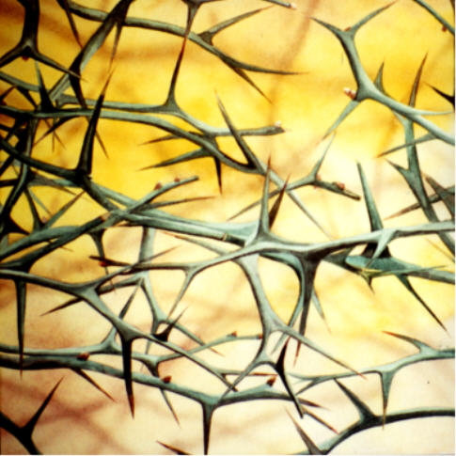

Slide 12
The tree of life was on each side of the river. The leaves of the tree are for the healing of all people.

Slide 13
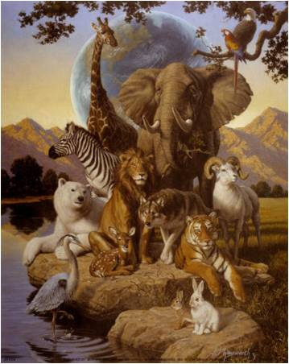
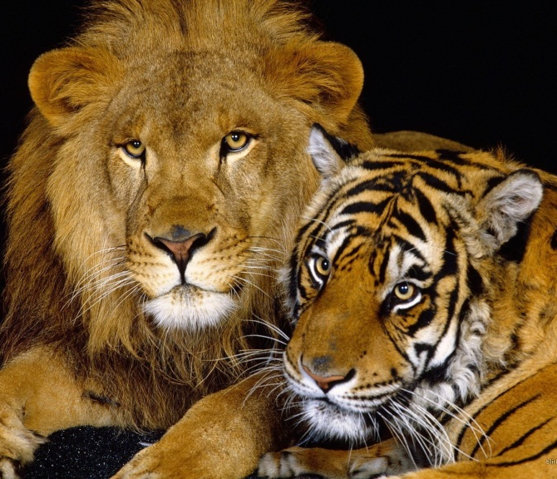
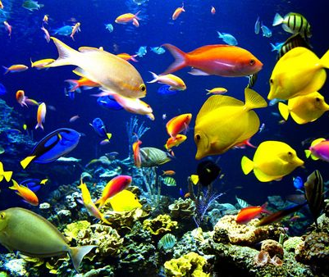
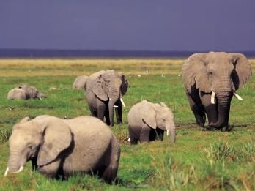
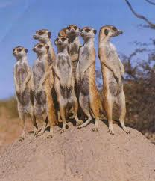
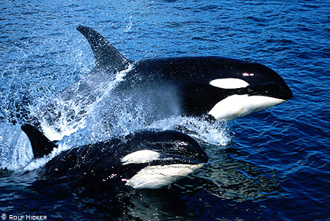
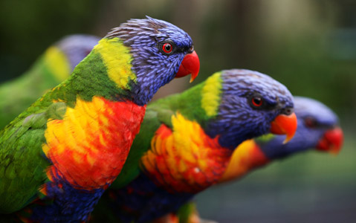
³¹ God looked at everything He had made, and it was very good.

Slide 14
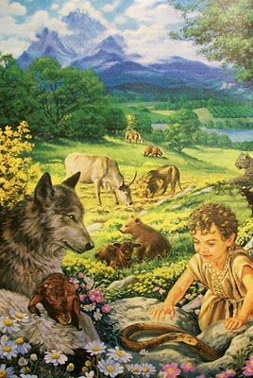
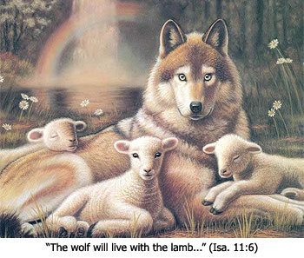
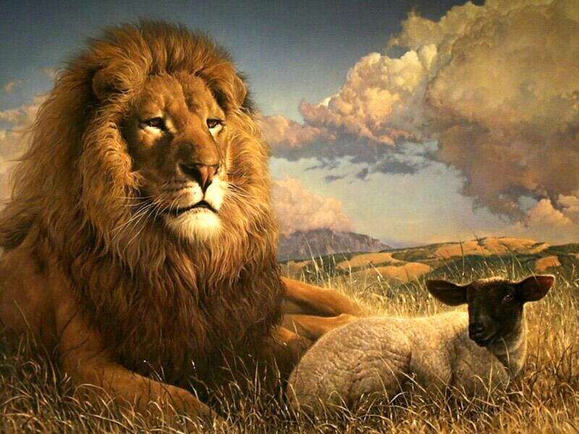

Slide 15
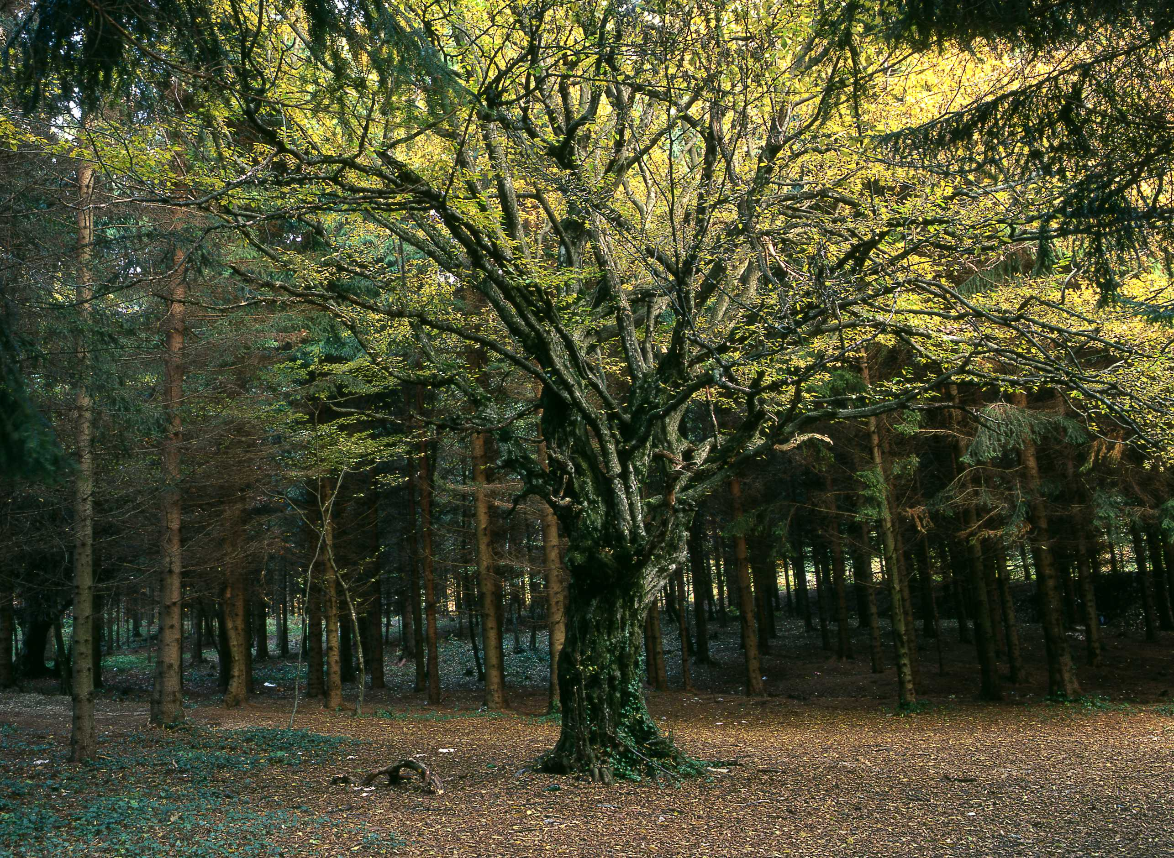
SIN
Shove off God!
I’m in charge!
No to your rules!

Slide 16
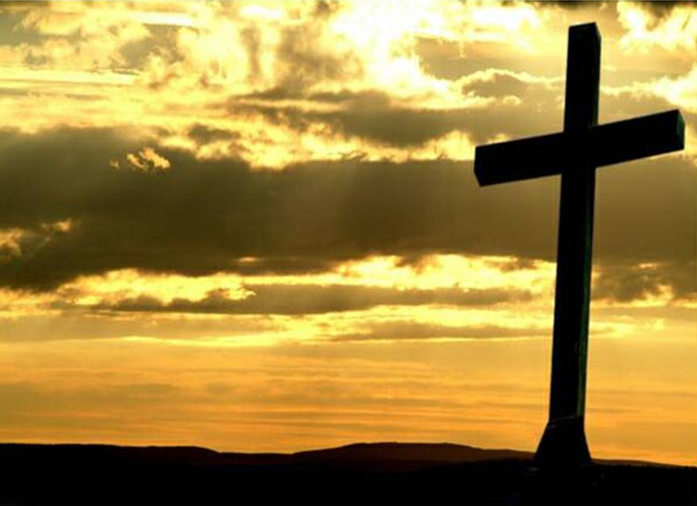
¹⁸ Christ himself suffered for sins once. He was not guilty, but he suffered for those who are guilty to bring you to God.

Slide 17
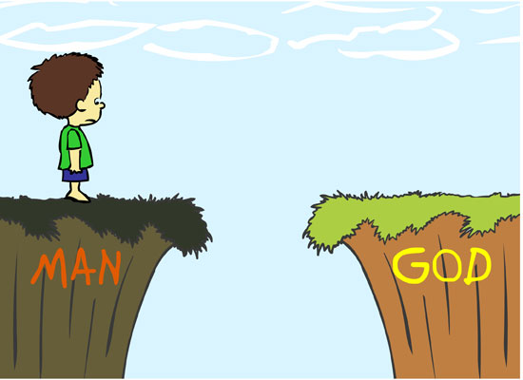
Jesus

Slide 18
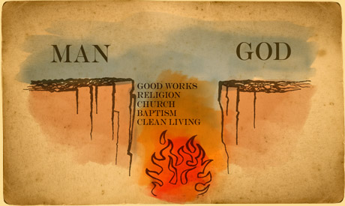
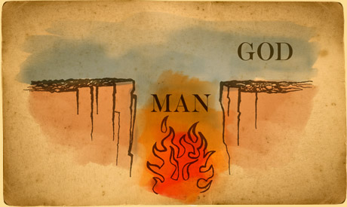

Slide 19
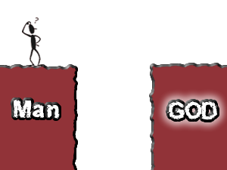

Slide 20
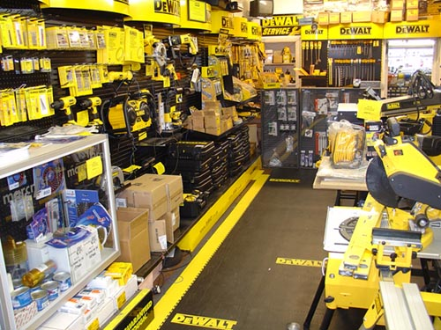
Fixit Factory QUIZ

Slide 21
“The One who was sitting on the throne said, "Look! I am making everything new!".”
Rev 21v5

Slide 22
“What kind of man is this! Even the wind and waves obey Him".”
Mark 4v41

Slide 23
“The tree of life was on both sides of the river. It’s leaves are for the healing of all people.”
Rev 22v2

Slide 24
“Then wolves will live in peace with lambs, and leopards will lie down to rest with goats.”
Isaiah 11v6

Slide 25
There will come a day, The Lord did say, When my people will be made new. I will lead them back to me And they will be made new, And they will be made new.

Slide 26
There will come a day, The Lord did say, When my people will be made new. I’ll forgive their sinfulness And they will be made new, And they will be made new.

Slide 27
There will come a day, The Lord did say, When my people will be made new. I will make them clean and pure And they will be made new, And they will be made new.

Slide 28
There will come a day, The Lord did say, When my people will be made new. Jesus came to seek and save And we have been made new, And we have been made new.

Slide 29
The Lord is King

Slide 30
09.15am Team Arrive
09.30am Team Bible focus and prayer
09.40am Team briefing
09.50am Into positions ready to welcome children
10.00am Open doors; Registration; Groups
10.15-10.55am Super Heroes Briefing:
Mark is leading, explaining and guiding the children through the day and story
Welcome & Notices
Song
Intro Activity
Song
Talk
Quiz
Song
10.55-12.15pm GROUP ASSIGNMENTS:
15 minutes Group Work
15 minutes Crafts
15 minutes x 2 Sports Sportshall Comps.
12.15-12.30pm Super Heroes Debrief:
Review Group Assignments
Song
Memory Verse
Song
12.30pm FINISH & GOODBYE
!2.30 – 1.00pm Leaders Debrief & Refreshments

Slide 31
 | Group 1 | Group 2 | Group 3 | Group 4
10.55 – 11.10 | Group & Refreshments | Sport 1 | Craft | Sport 1
11.15 – 11.30 | Craft | Group & Refreshments | Sport 1 | Sport 2
11.35 – 11.50 | Sport 1 | Craft | Sport 2 | Group & Refreshments
11.55 – 12.10 | Sport 2 | Sport 2 | Group & Refreshments | Craft

